Slide 1
Concurrency
Saint Petersburg, 2019

Slide 2
Content
1
Hardware basics
2
Software basics
3
Java thread management
4
Concurrency general concept
5
Java concurrency implementation
6
Conclusion

Slide 3
Hardware basics

Slide 4
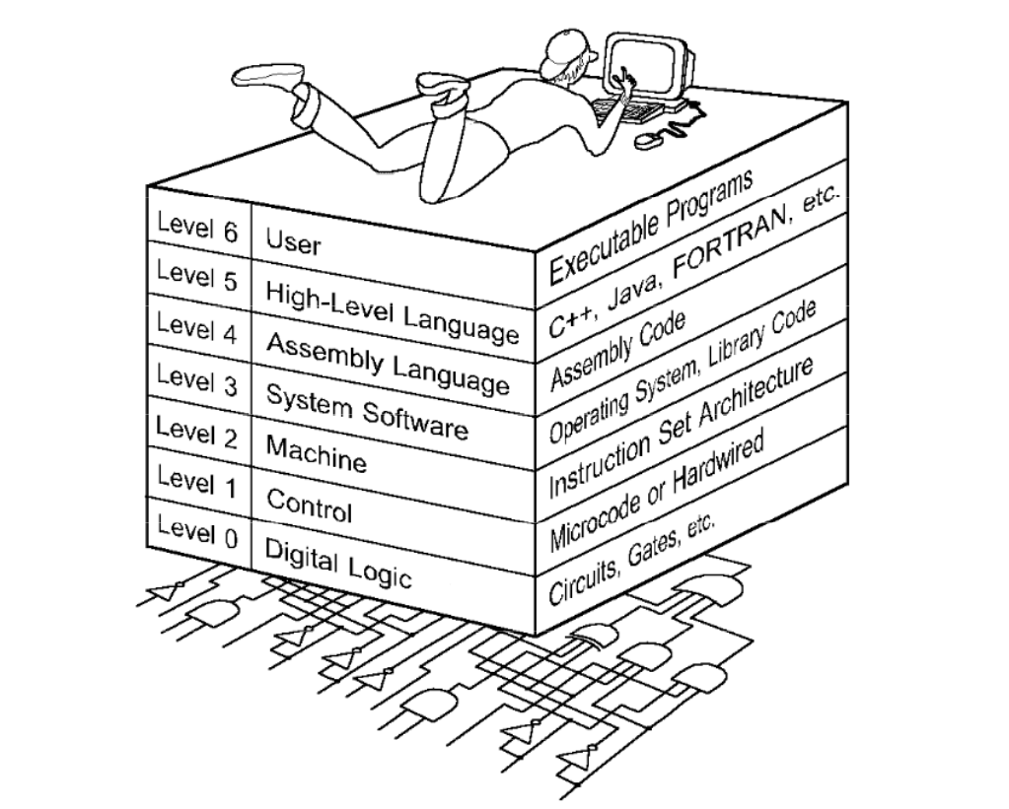
The World we are living in

Slide 5
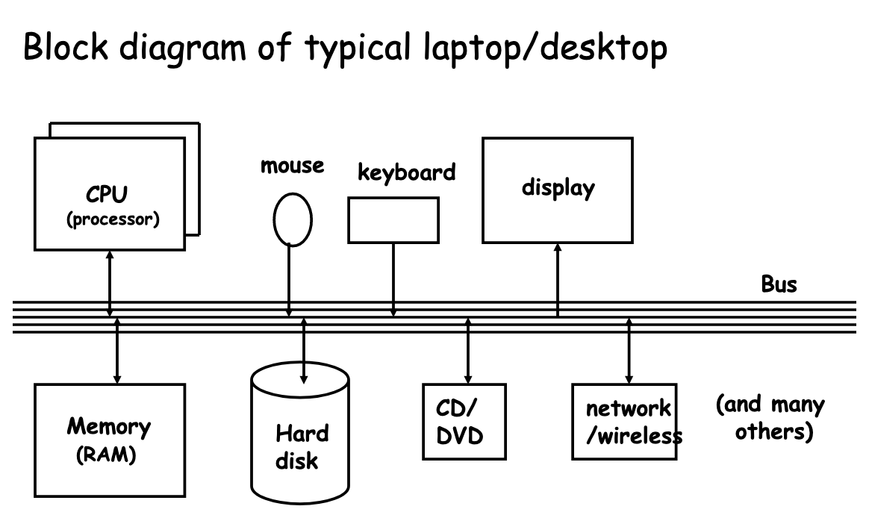
Computer architecture

Slide 6
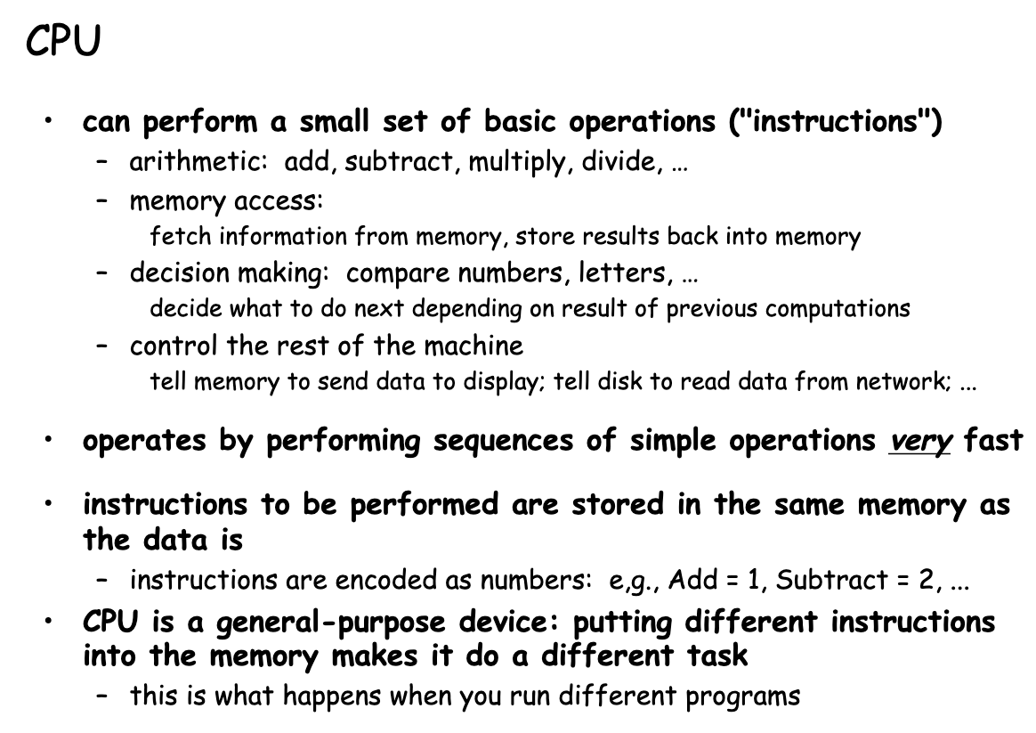
CPU

Slide 7
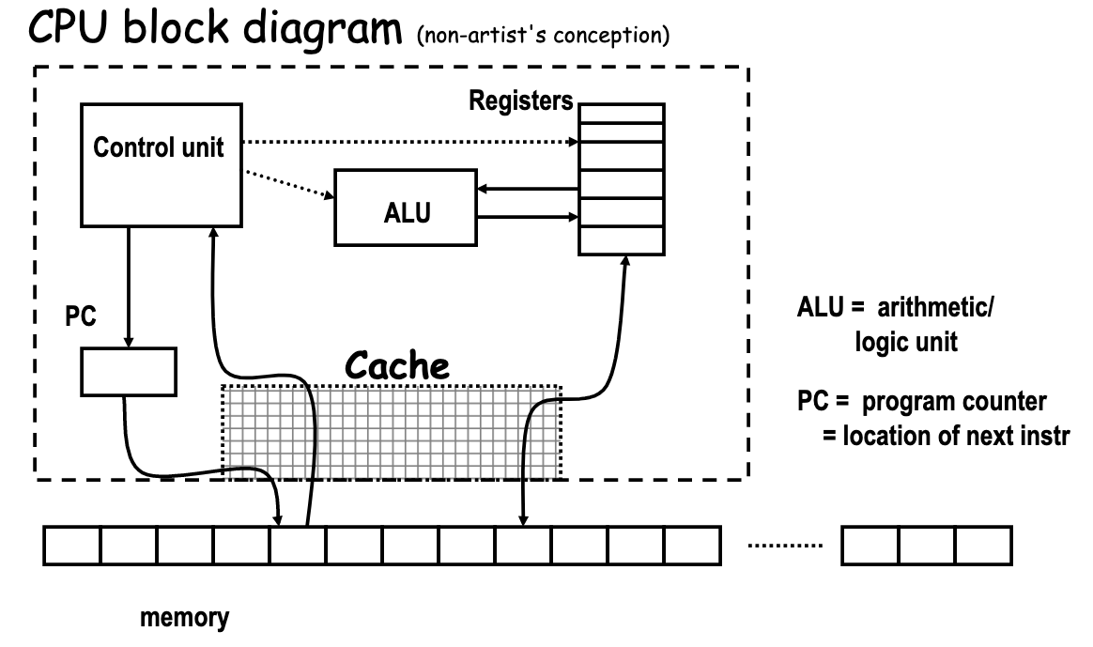
CPU

Slide 8
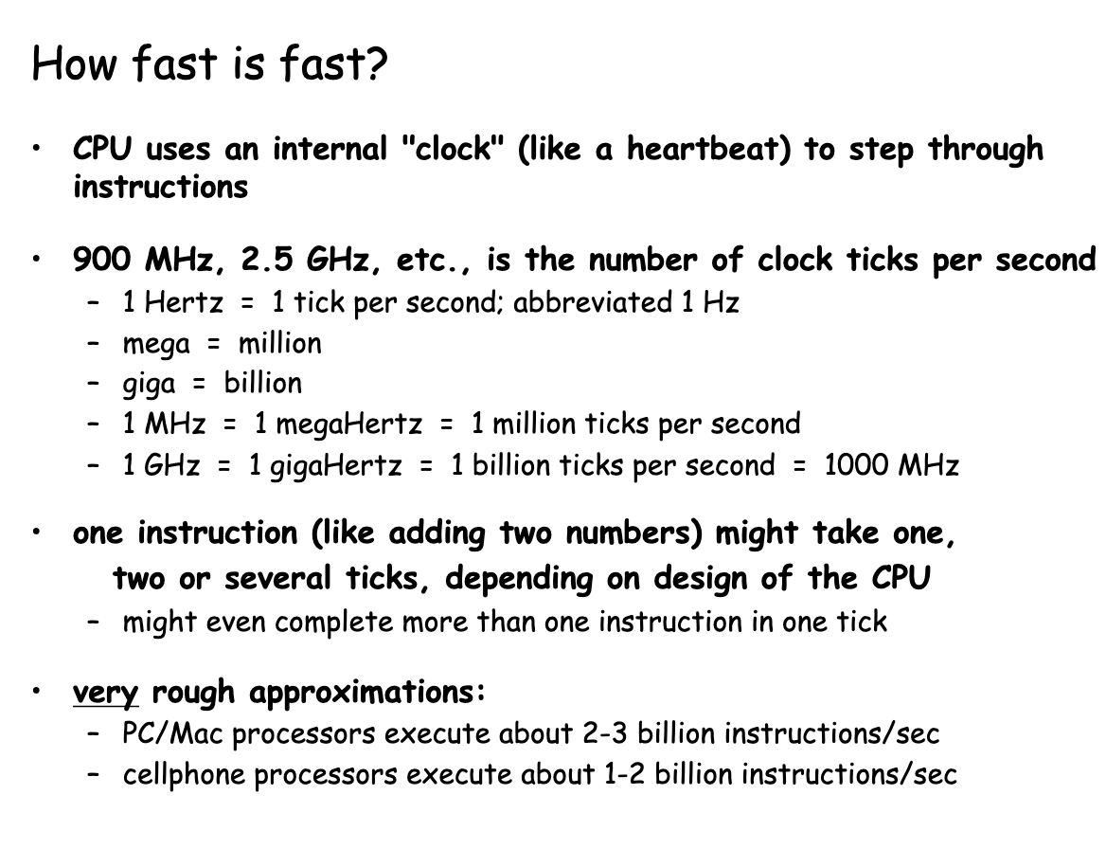
CPU

Slide 9
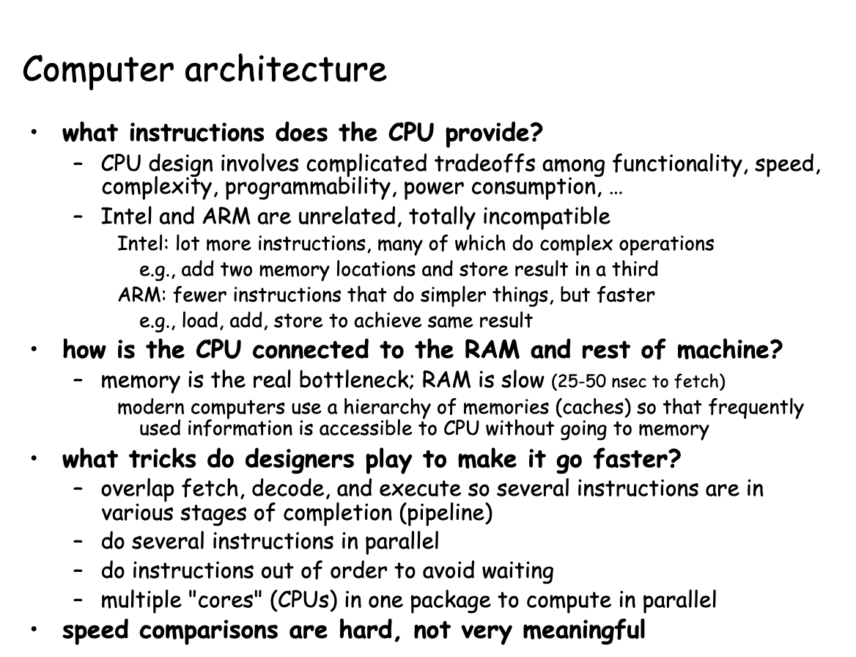
Computer architecture

Slide 10
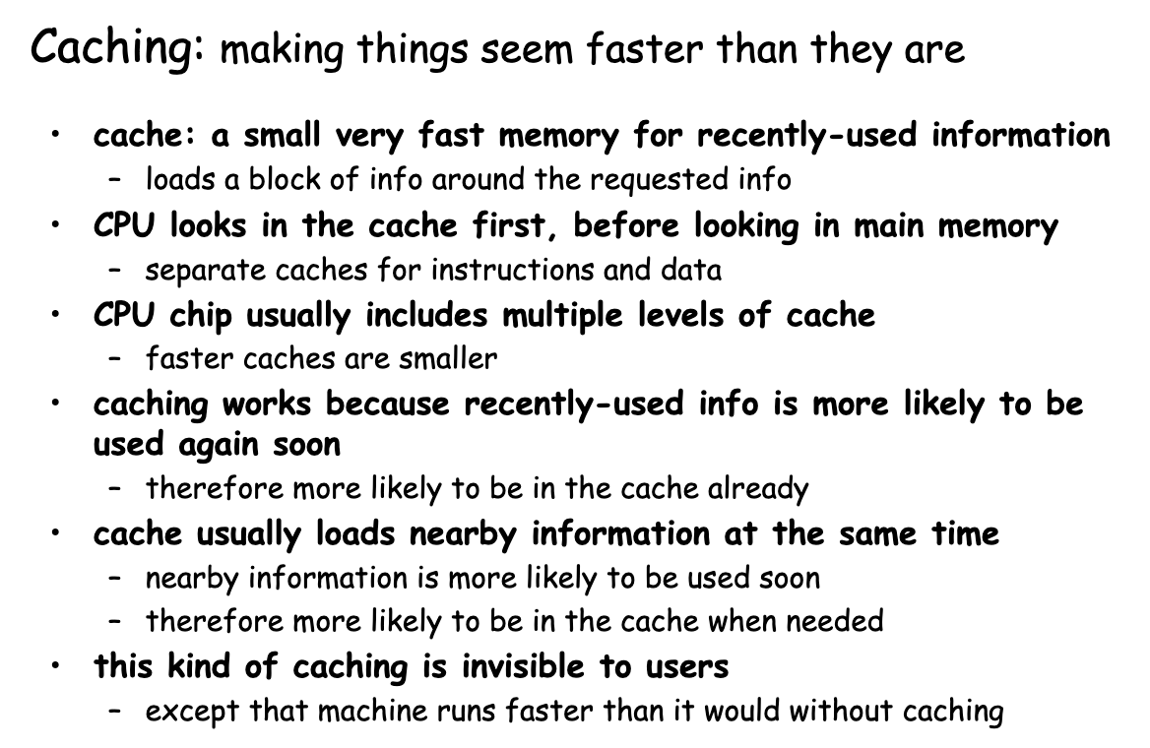
CPU architecture

Slide 11
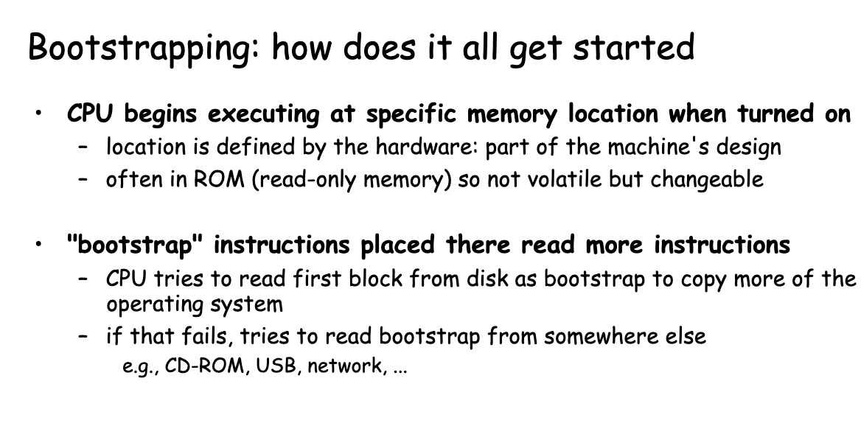
Bootstrapping

Slide 12
Software basics

Slide 13
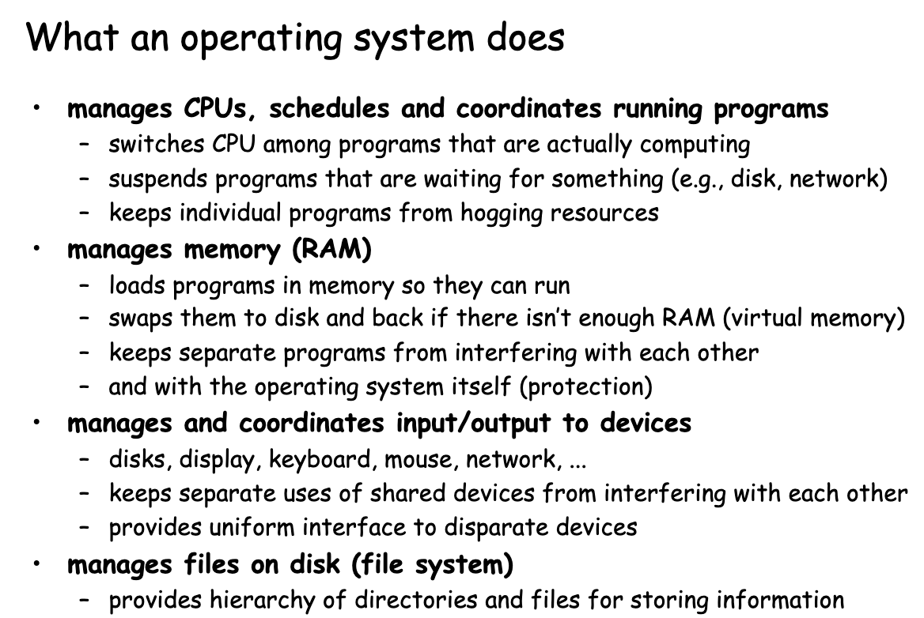
OS

Slide 14
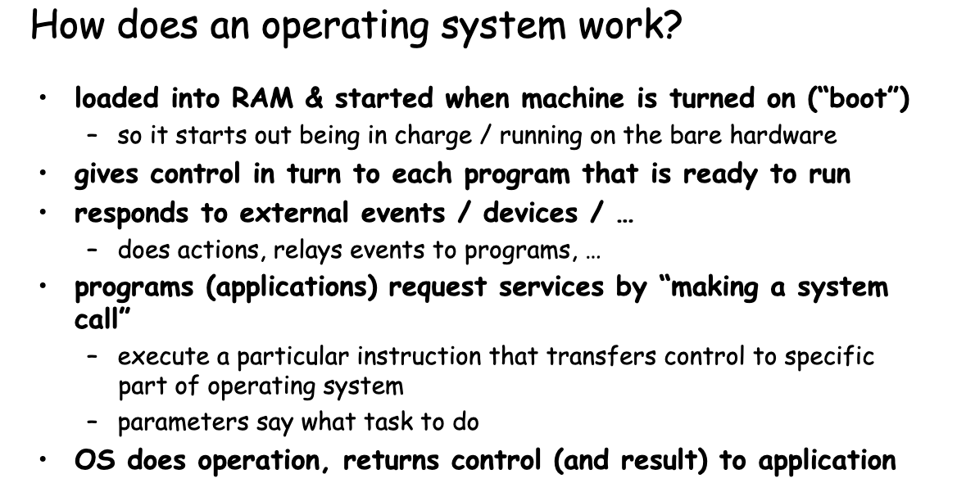
OS

Slide 15
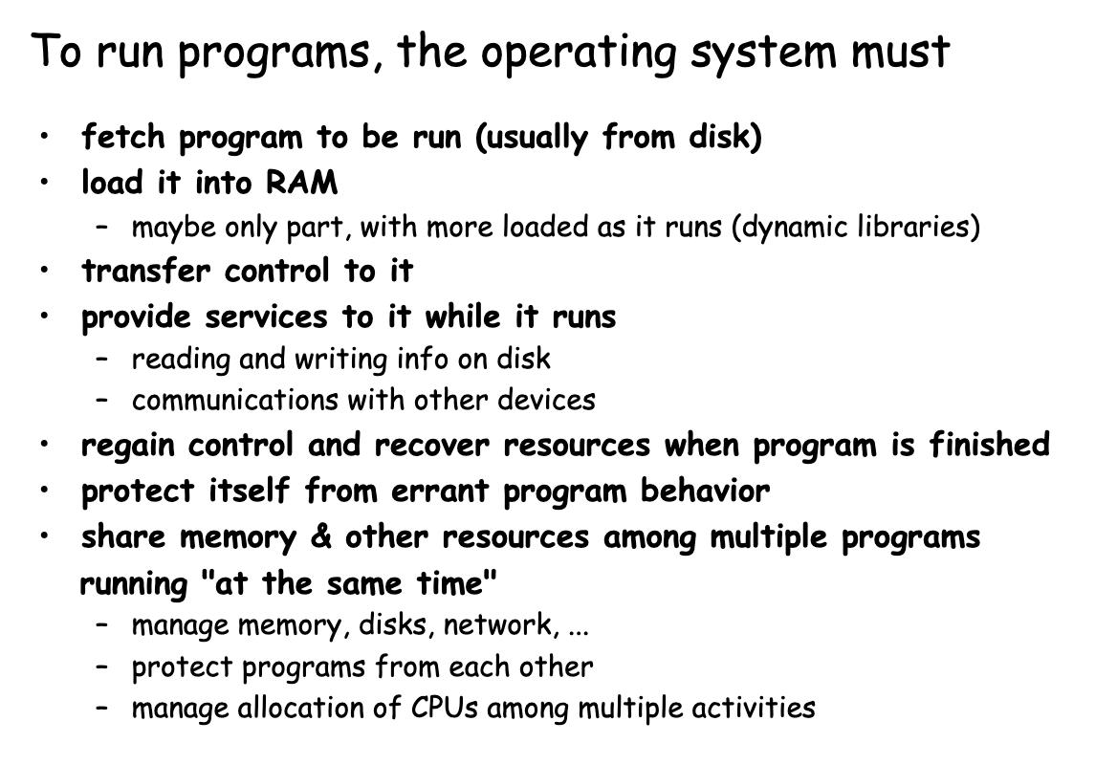
How to run programs?

Slide 16
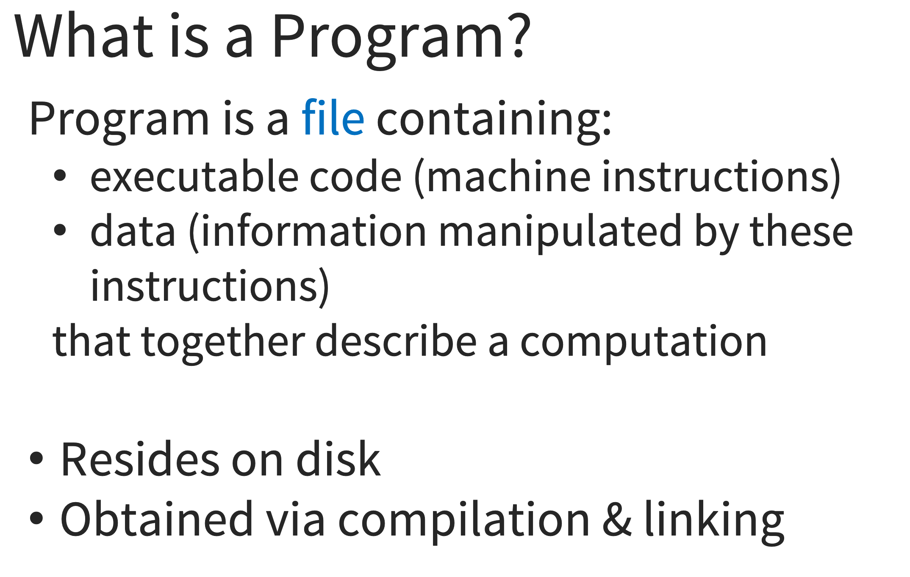
Programs

Slide 17
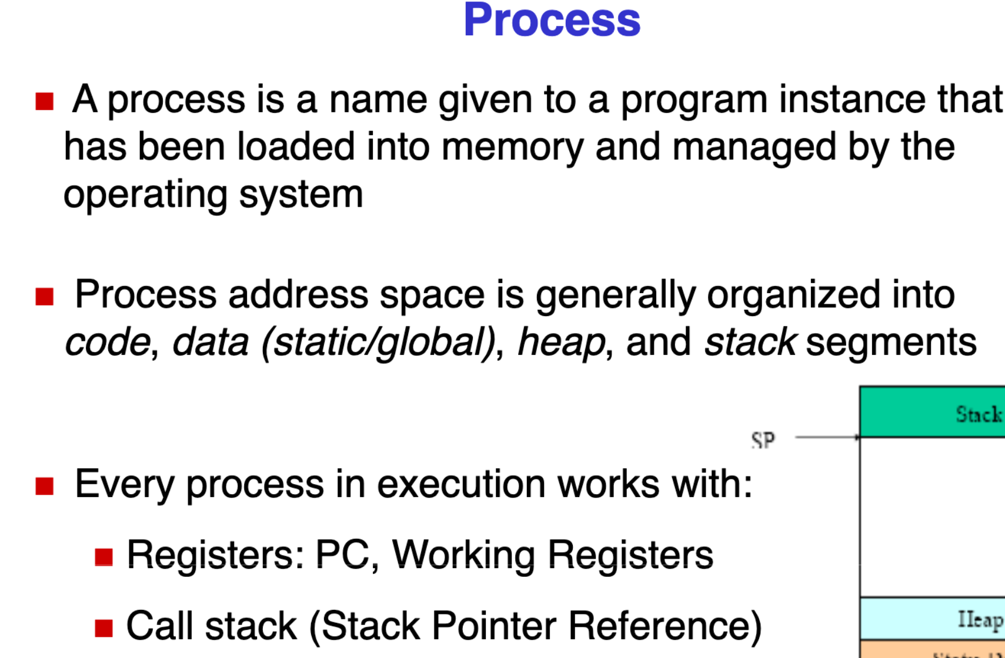
Process

Slide 18
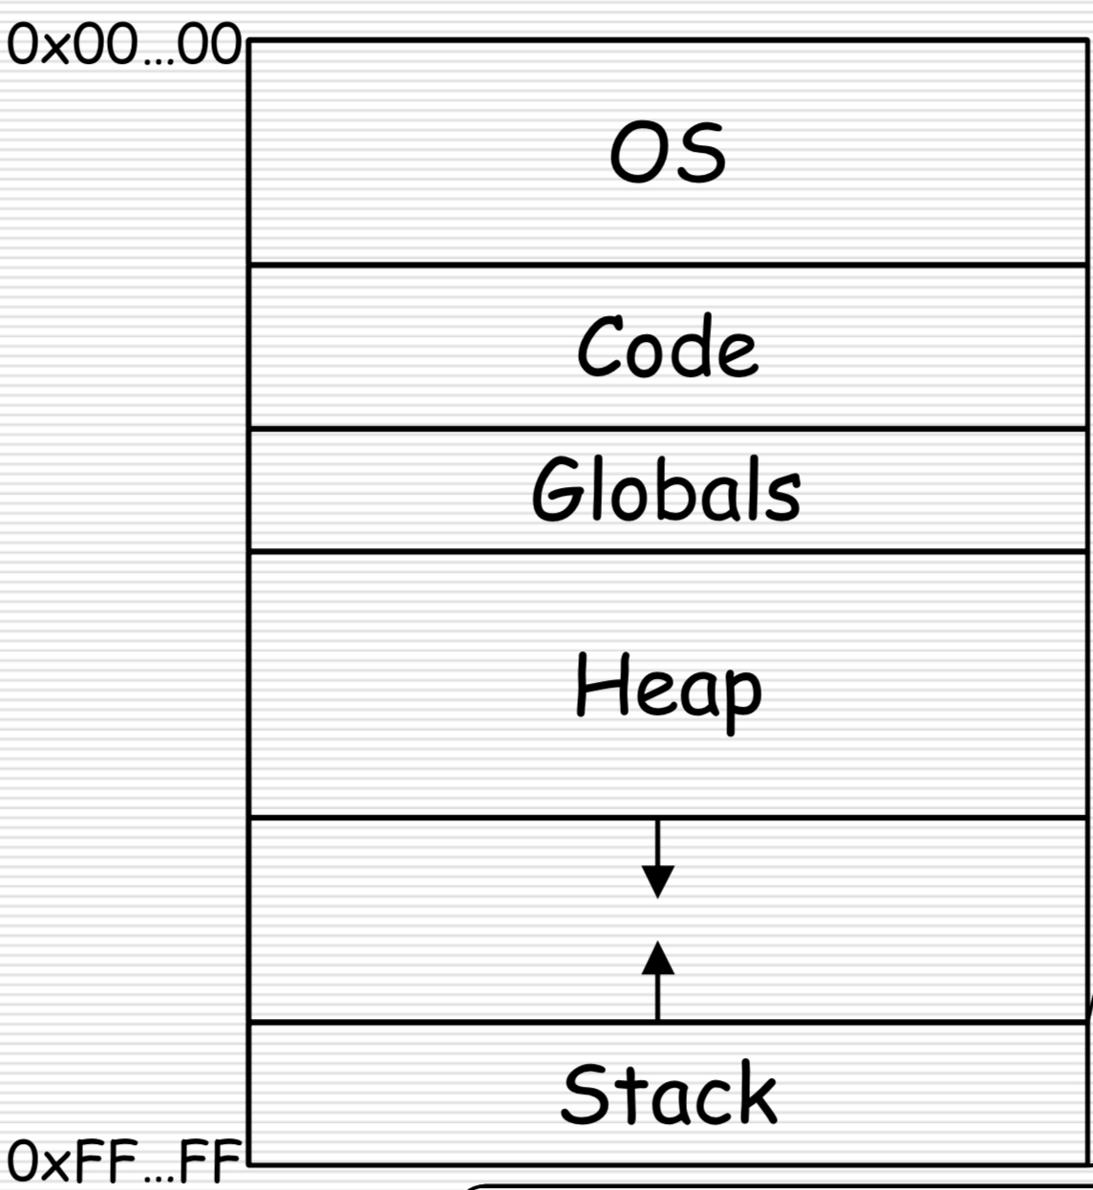
Process

Slide 19
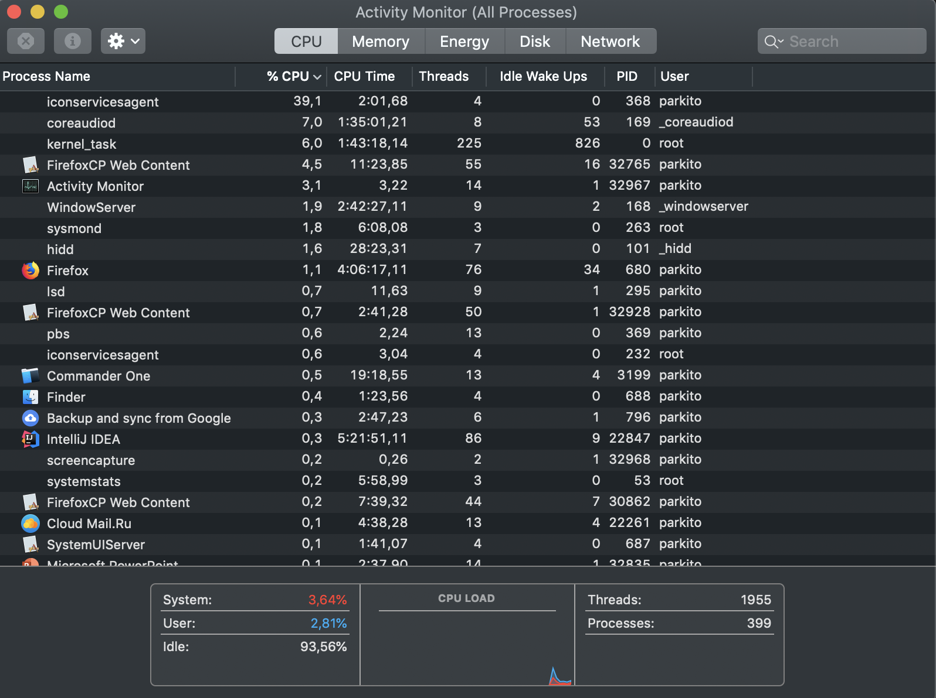
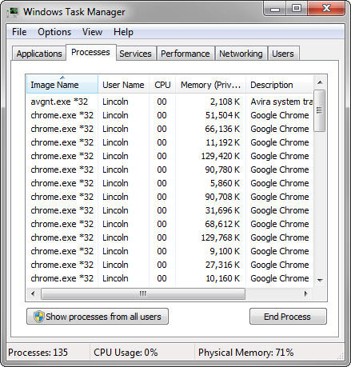
Processes

Slide 20
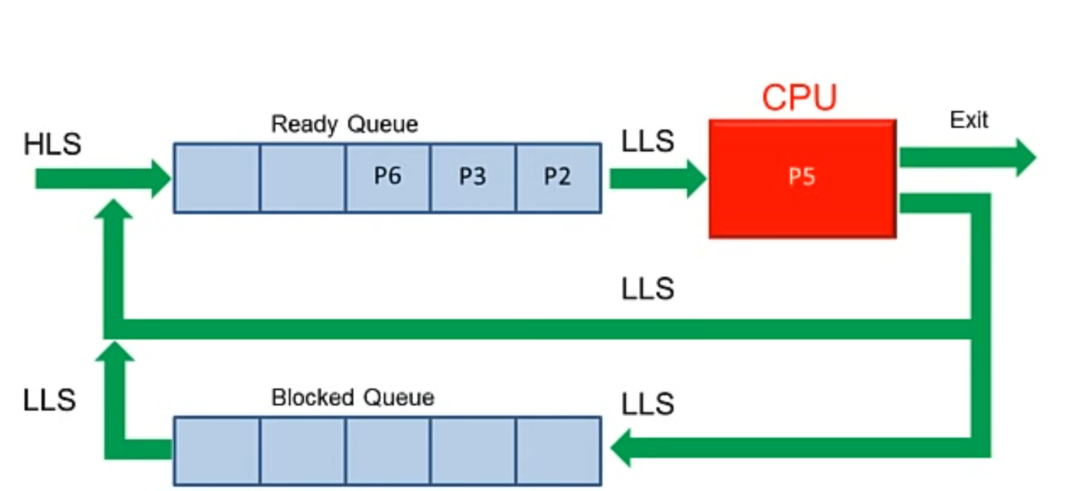
How processors work?

Slide 21
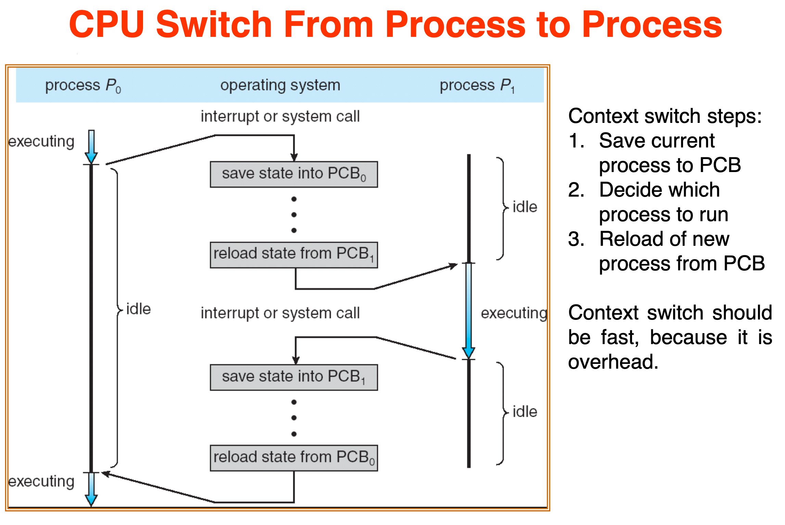
How processors work?

Slide 22
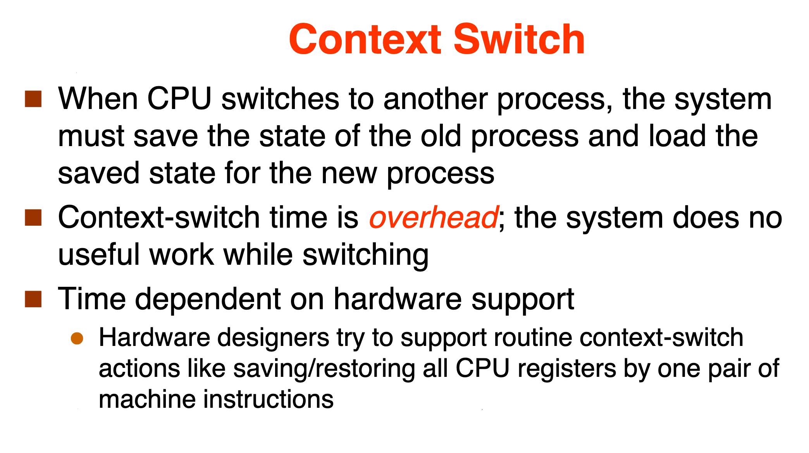
How processors work?

Slide 23
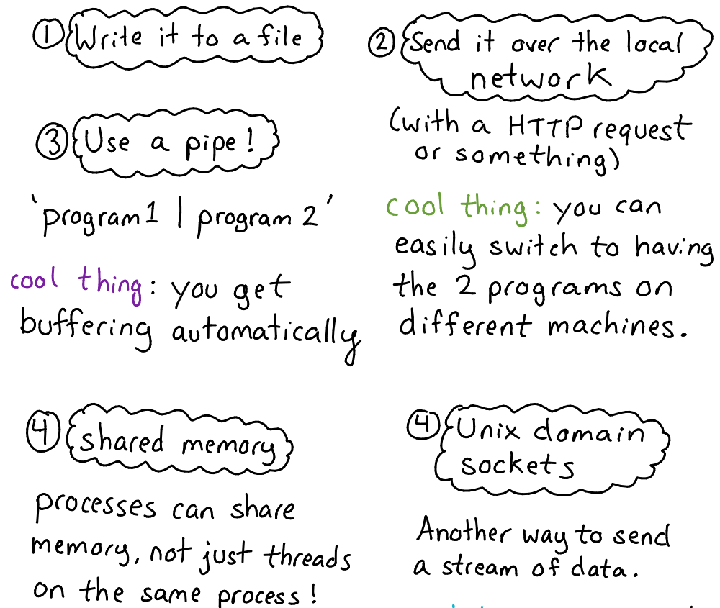
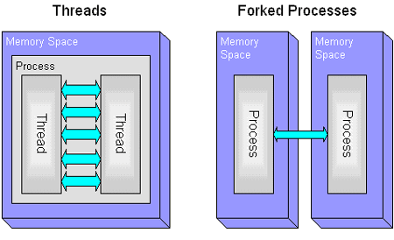
Inter-process communications

Slide 24
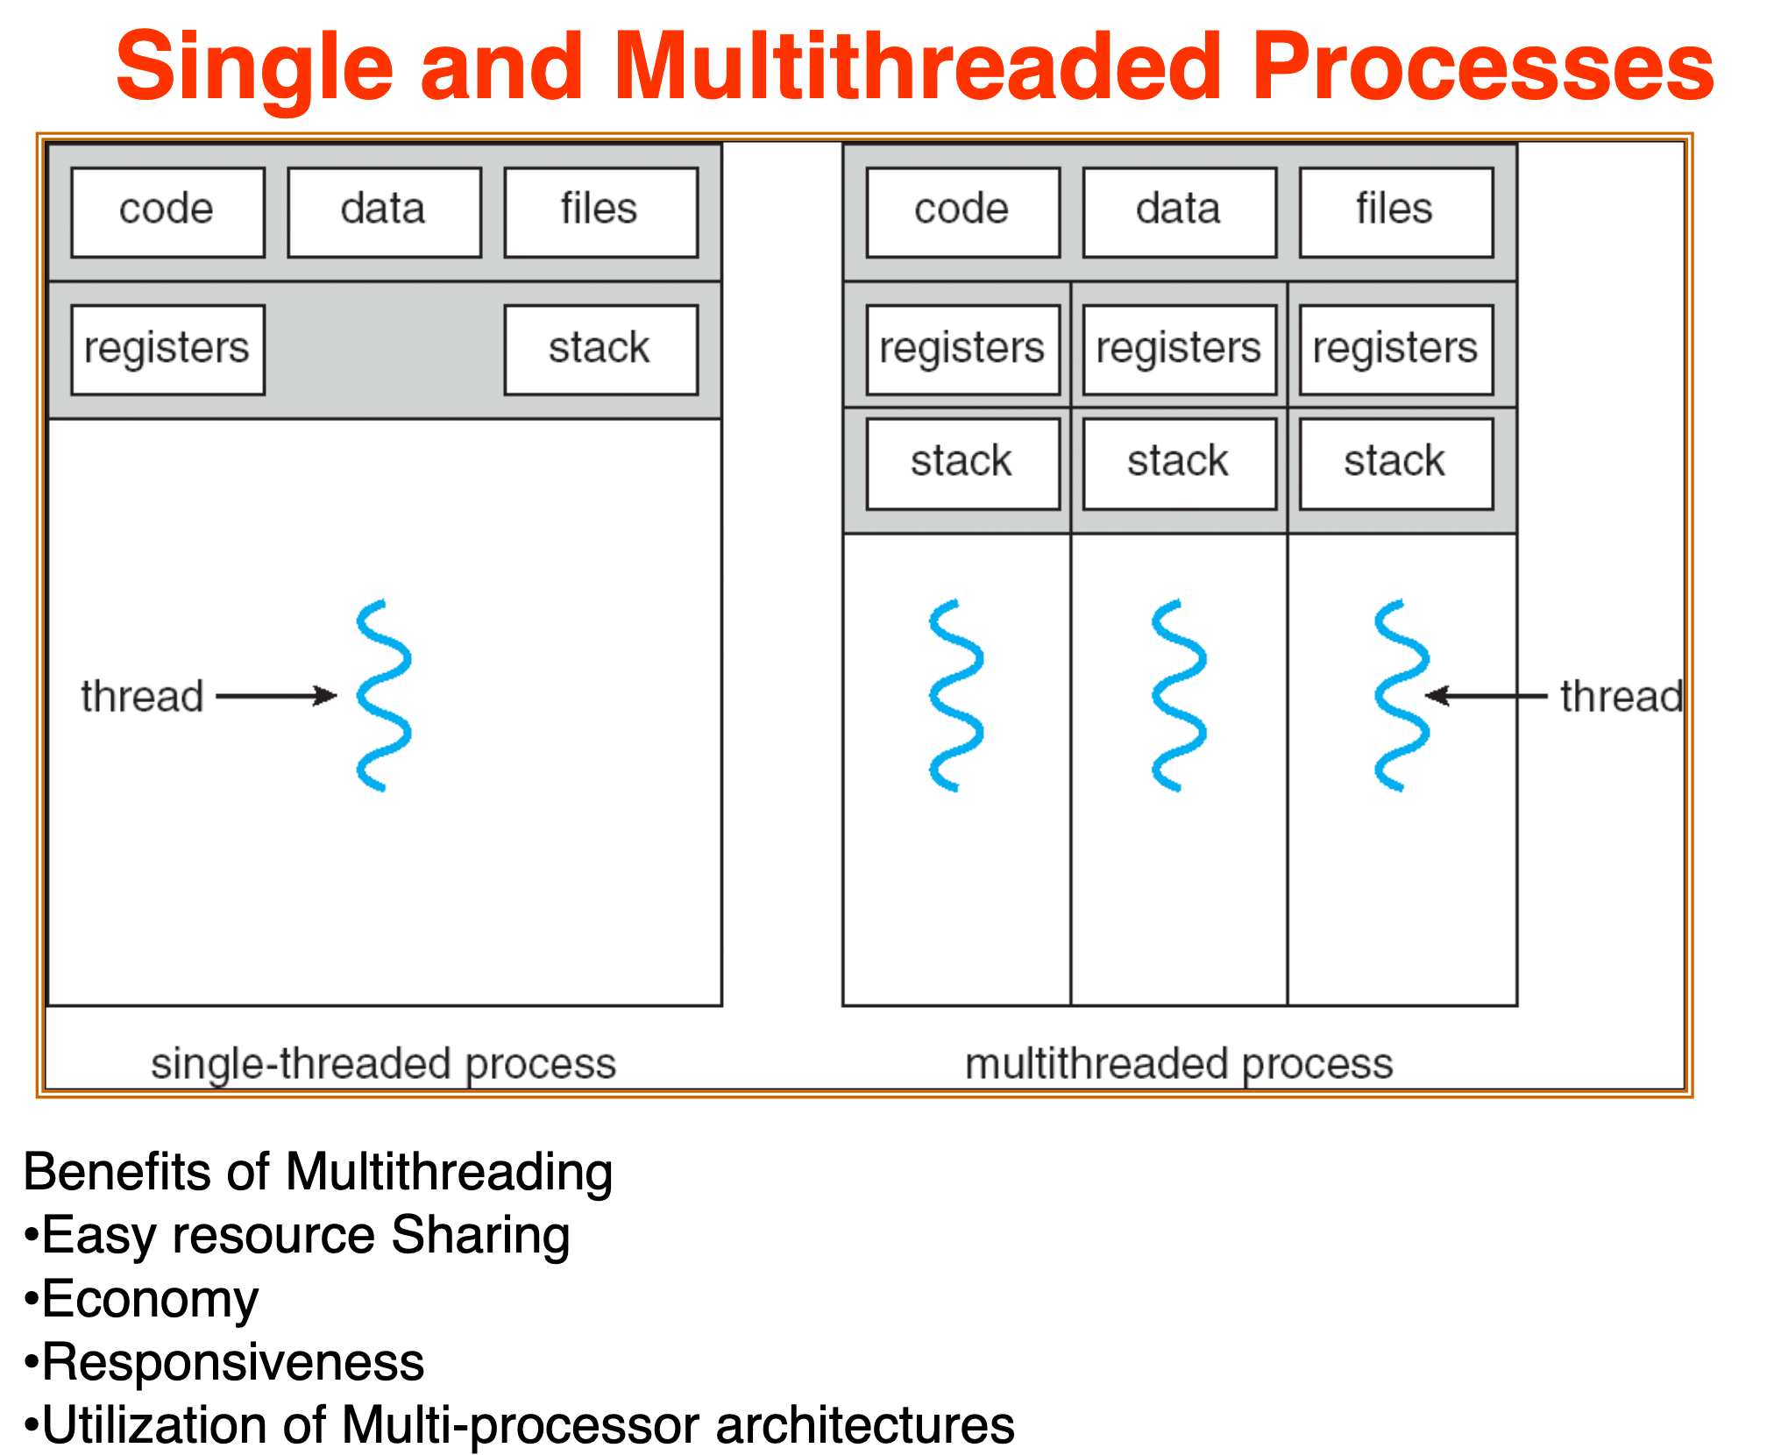
Threads

Slide 25
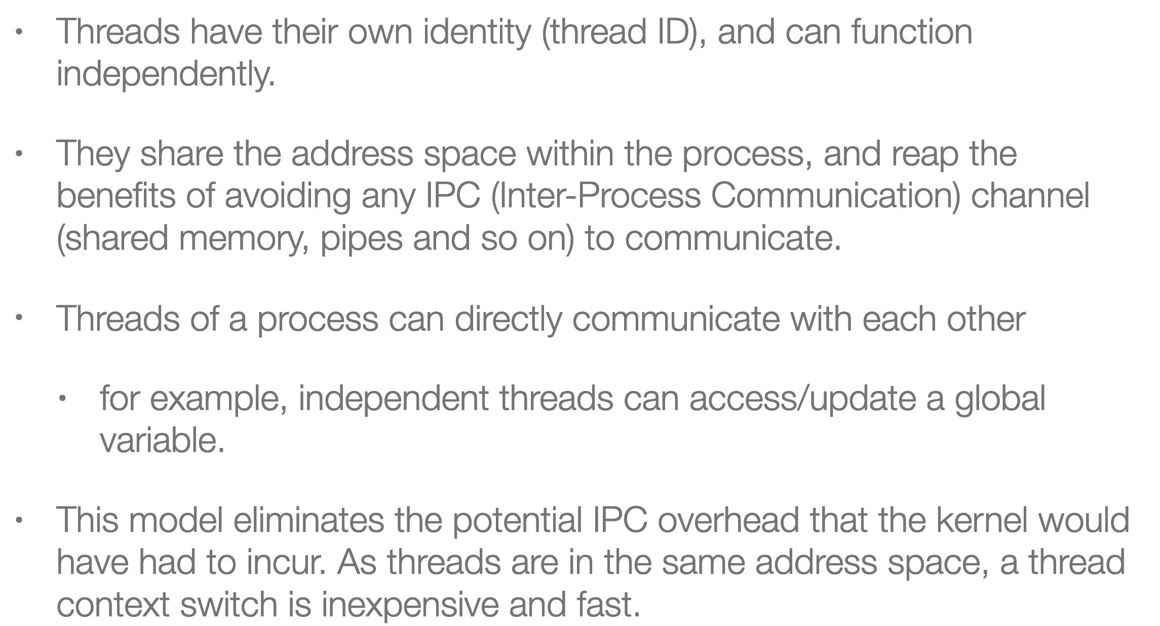
Threads

Slide 26
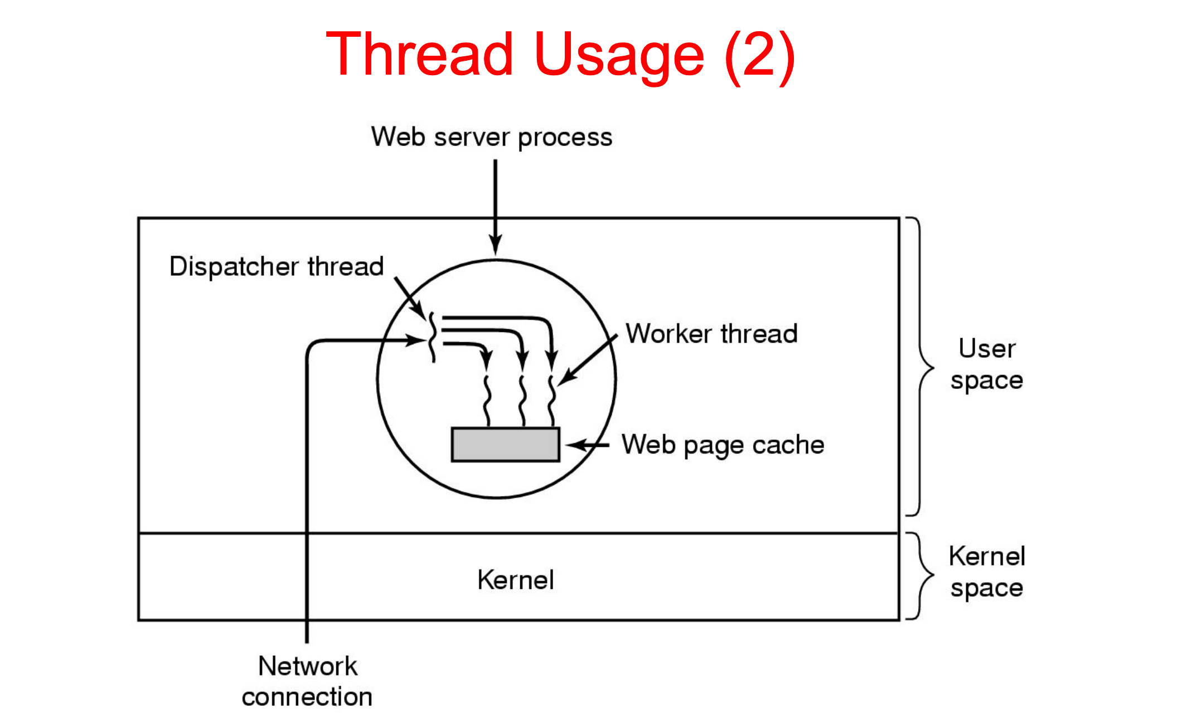
How processors work?

Slide 27
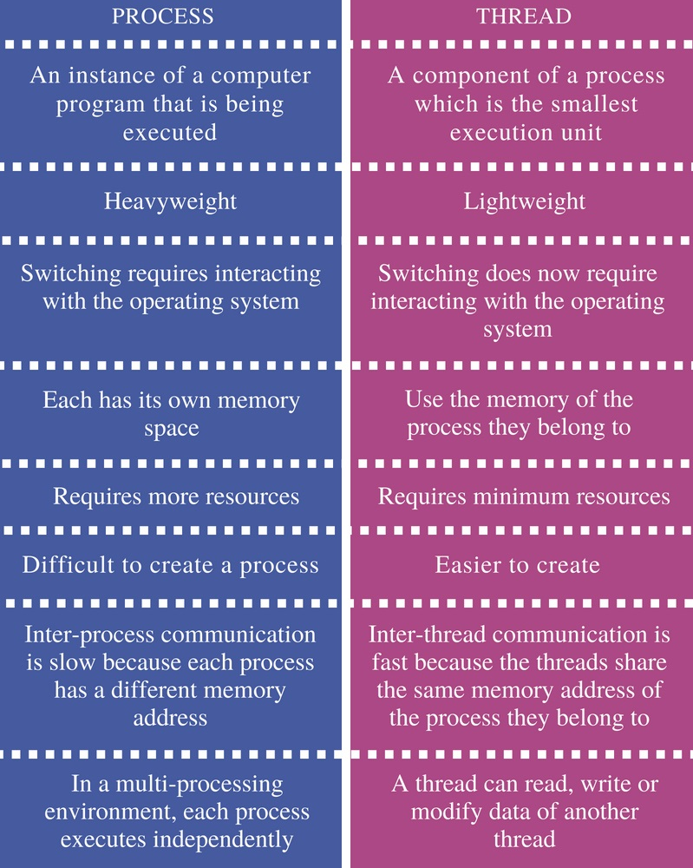
Inter-process communications

Slide 28
Java basics

Slide 29
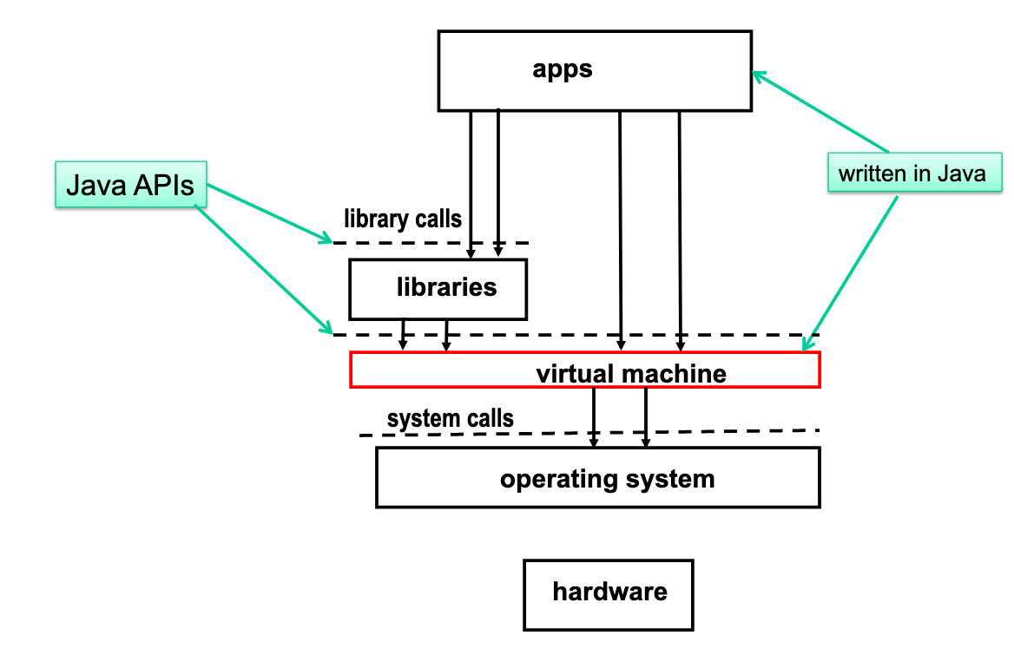
JVM execution architecture

Slide 30
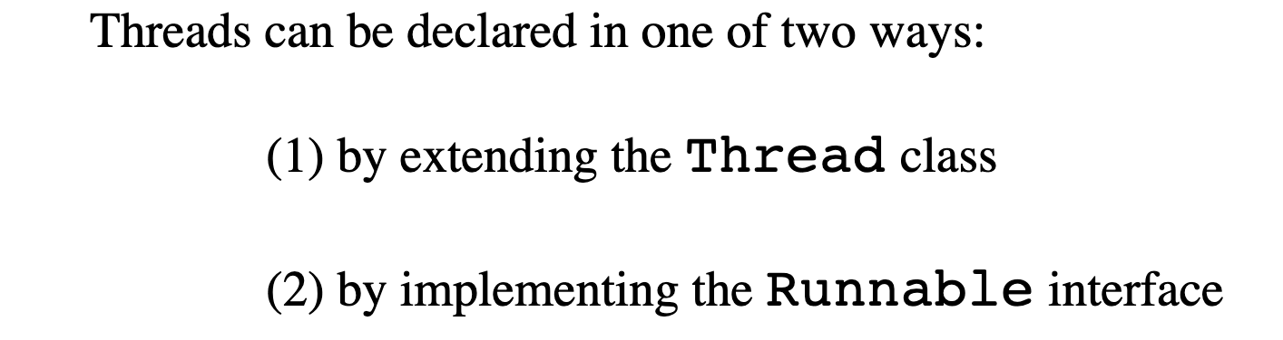
JVM execution architecture

Slide 31
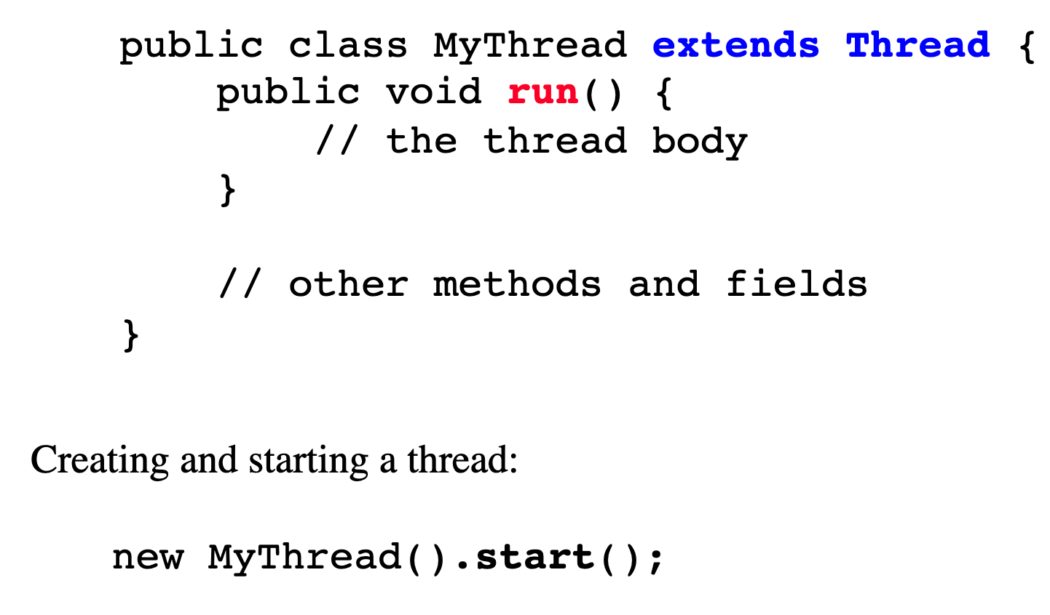
JVM execution architecture

Slide 32
JVM execution architecture

Slide 33
Example 1,2,3

Slide 34
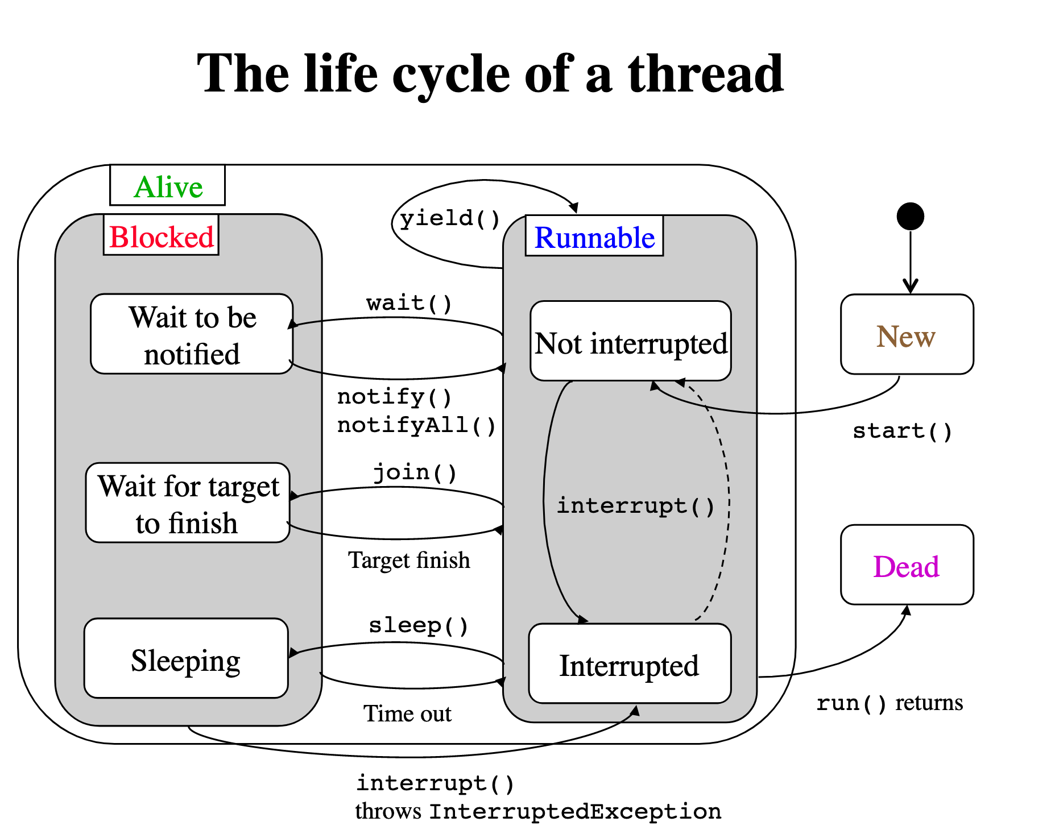
JVM execution architecture

Slide 35
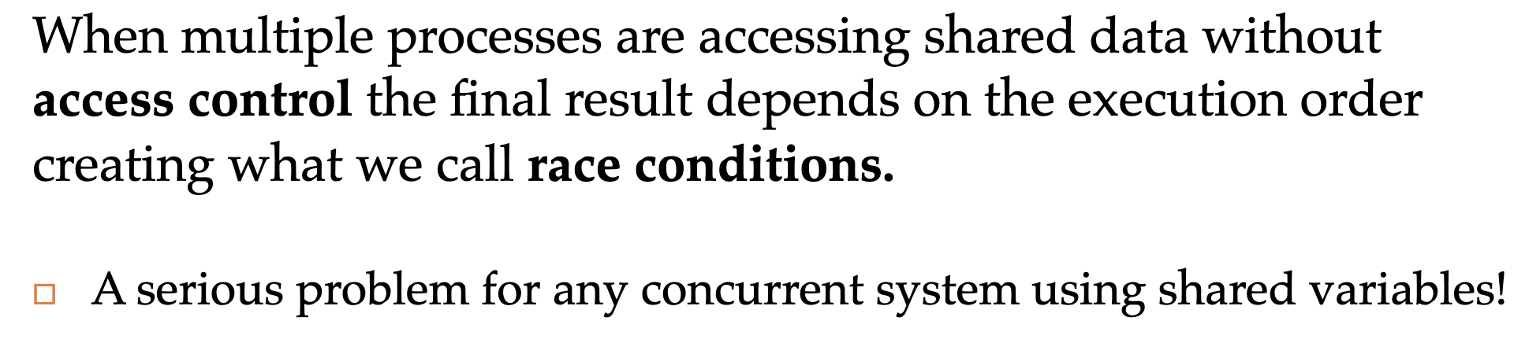
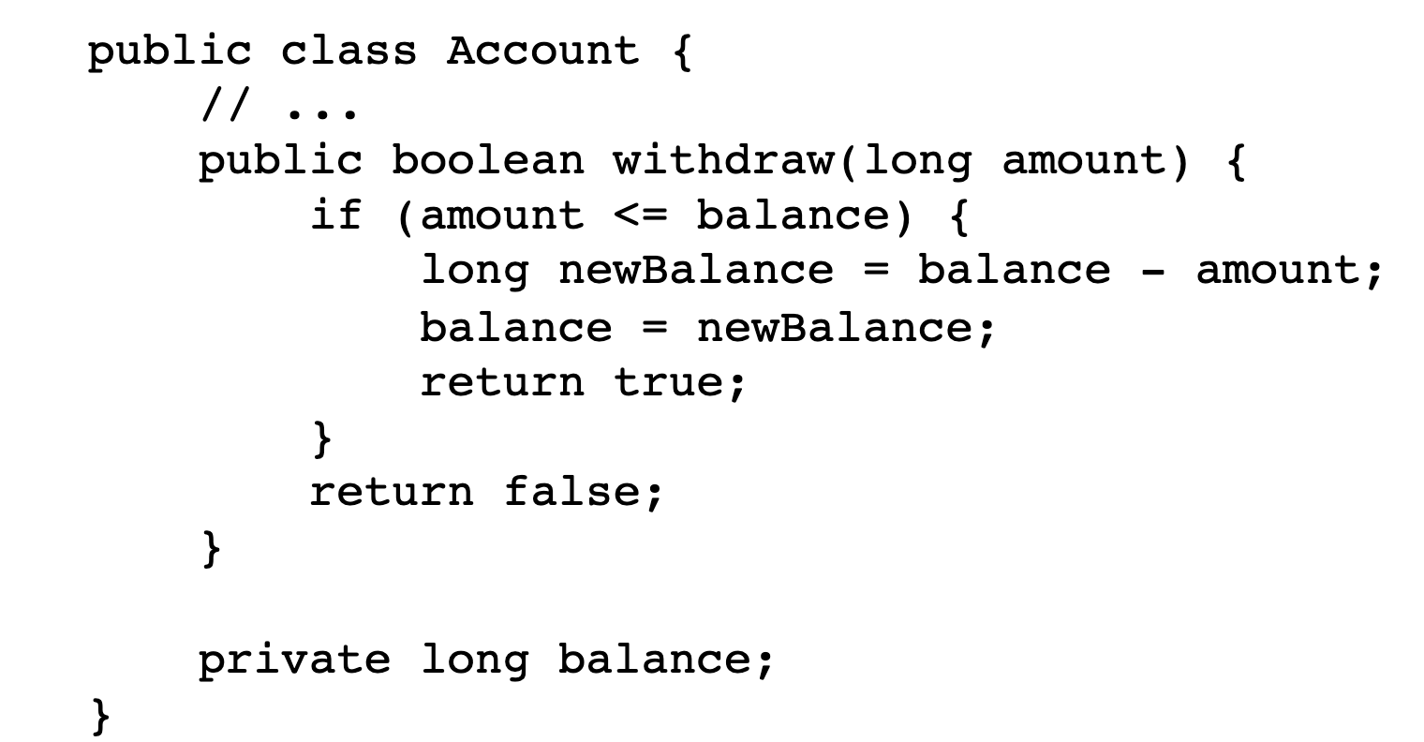
JVM execution architecture

Slide 36
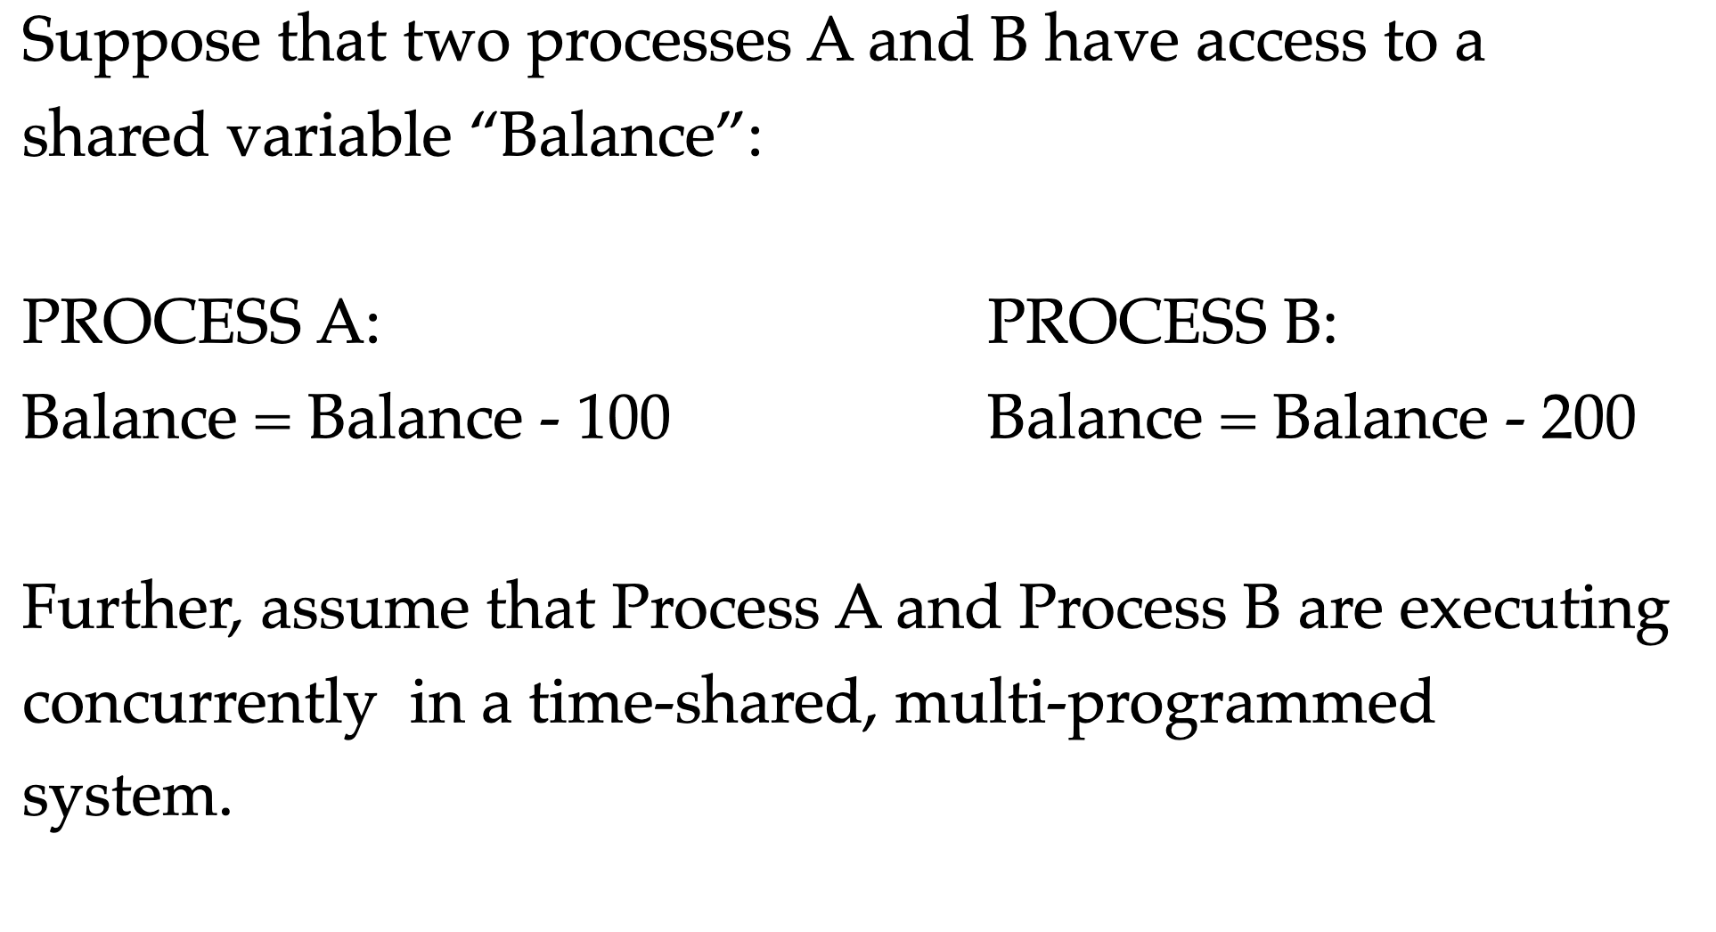
JVM execution architecture
threads
Thread A:
Thread B:
Thread
Thread

Slide 37
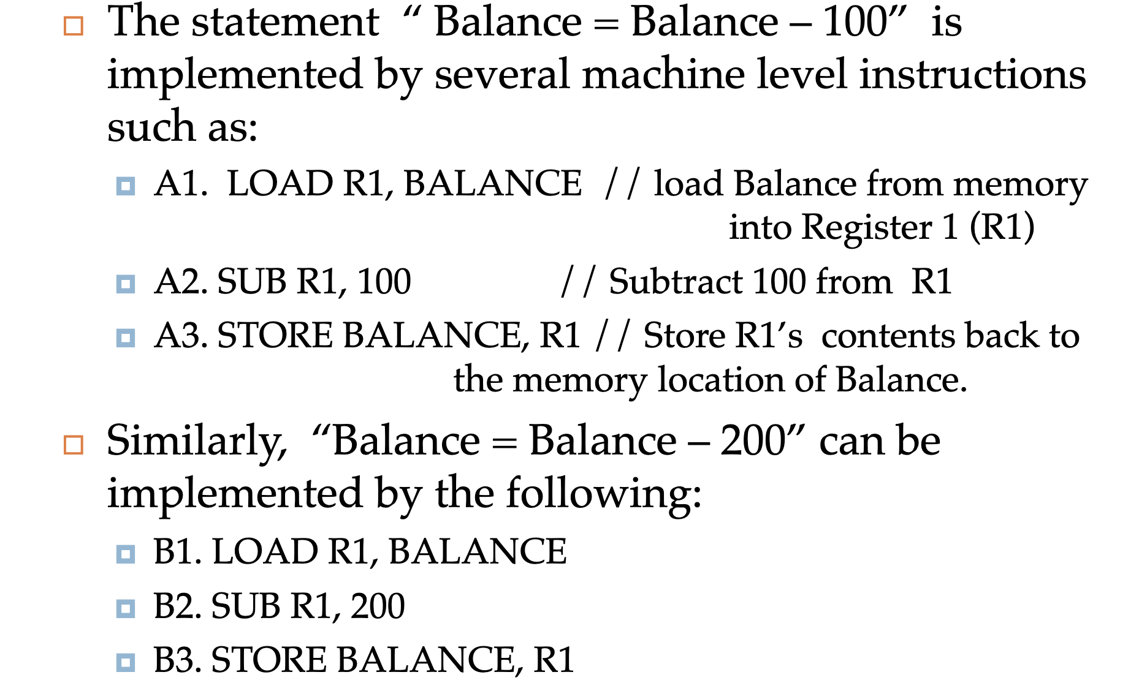
JVM execution architecture

Slide 38
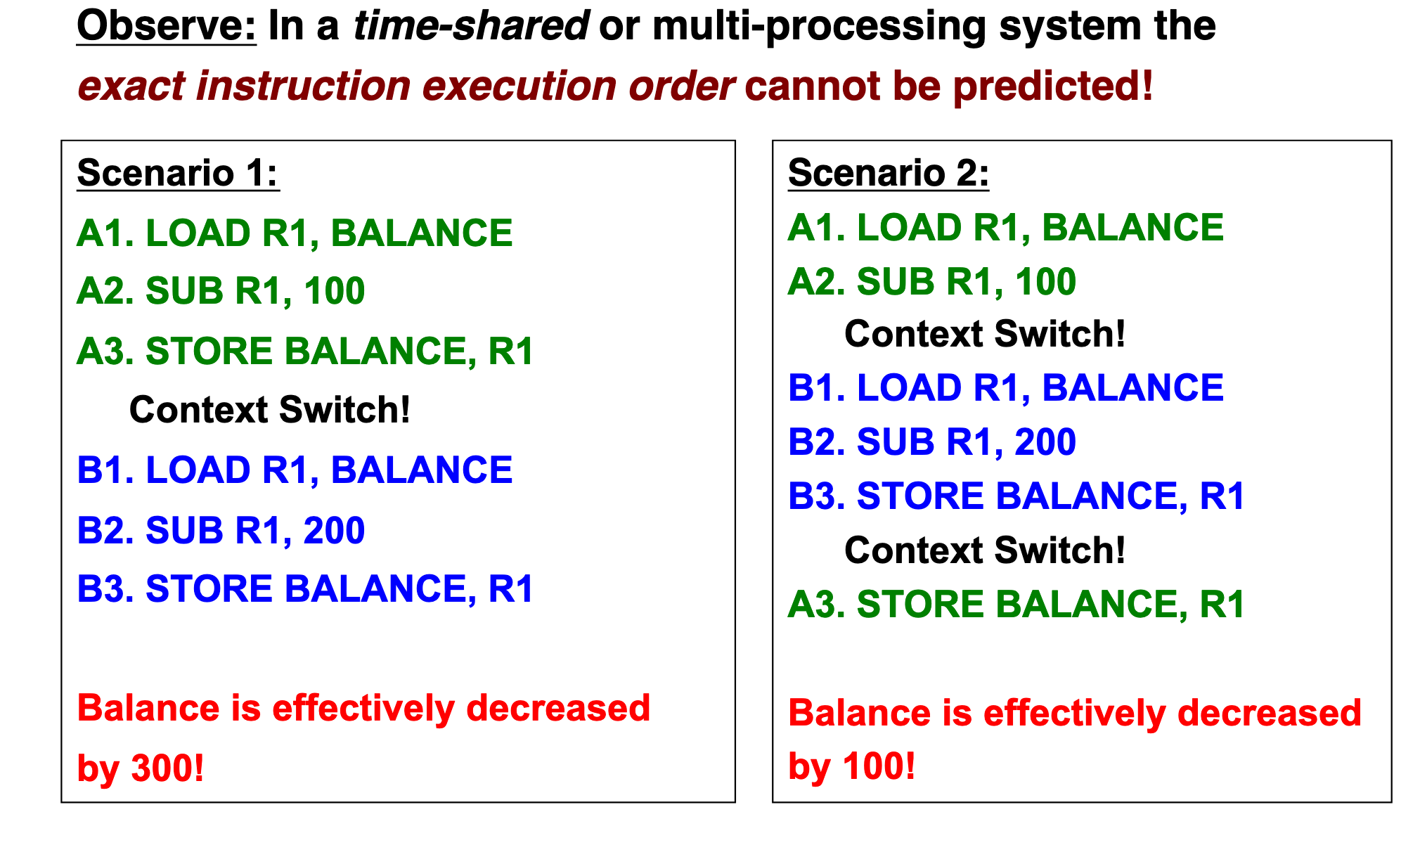
JVM execution architecture

Slide 39
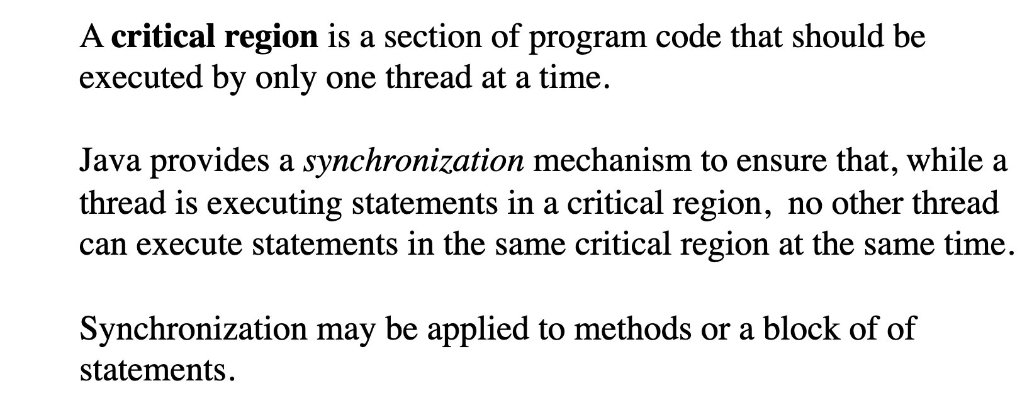
Critical region (section)

Slide 40
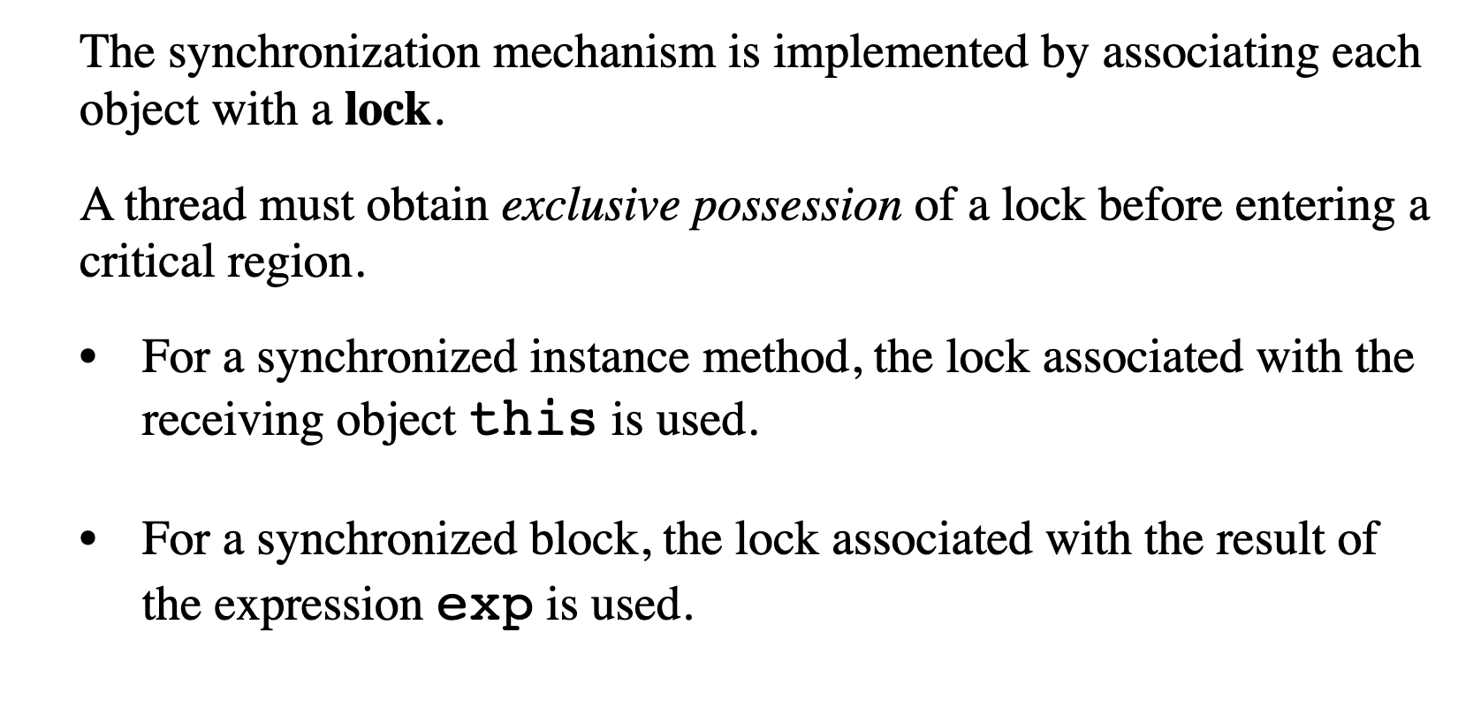
Lock (monitor)

Slide 41
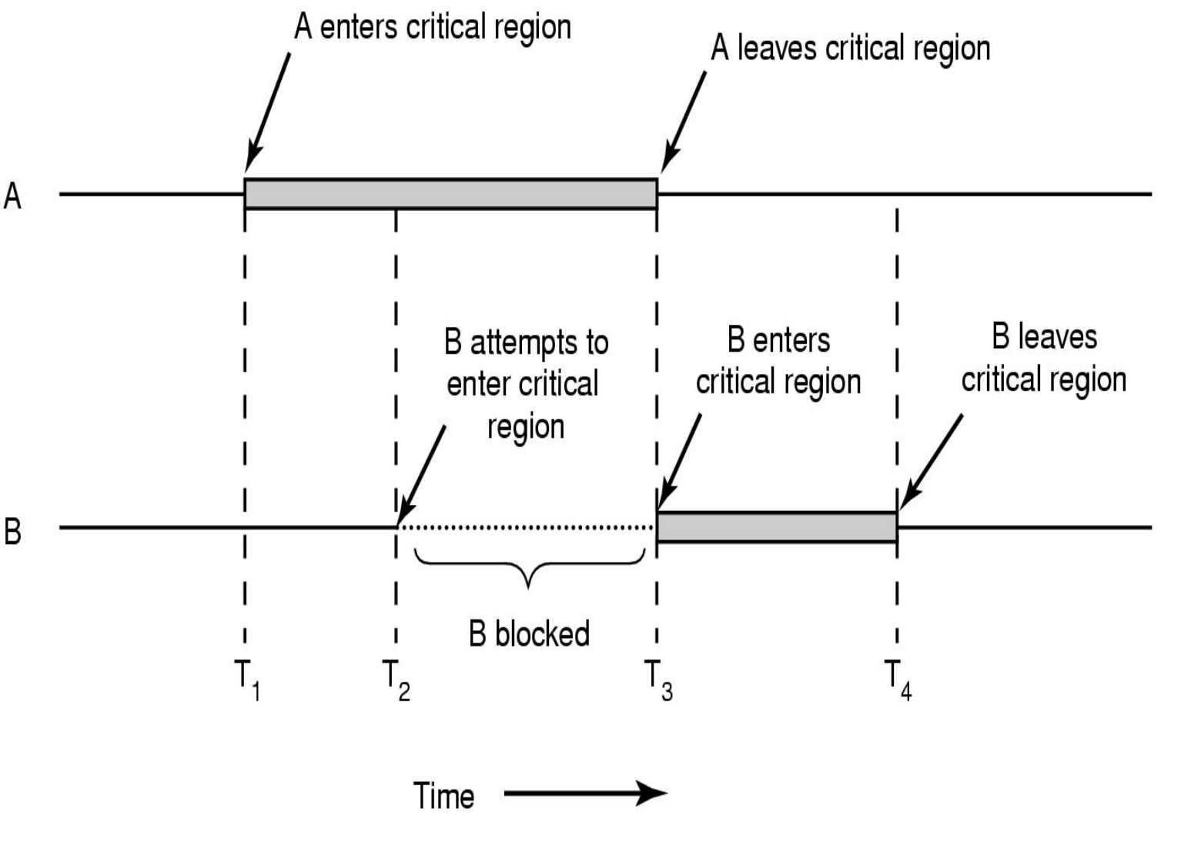
JVM execution architecture

Slide 42
Example 4

Slide 43
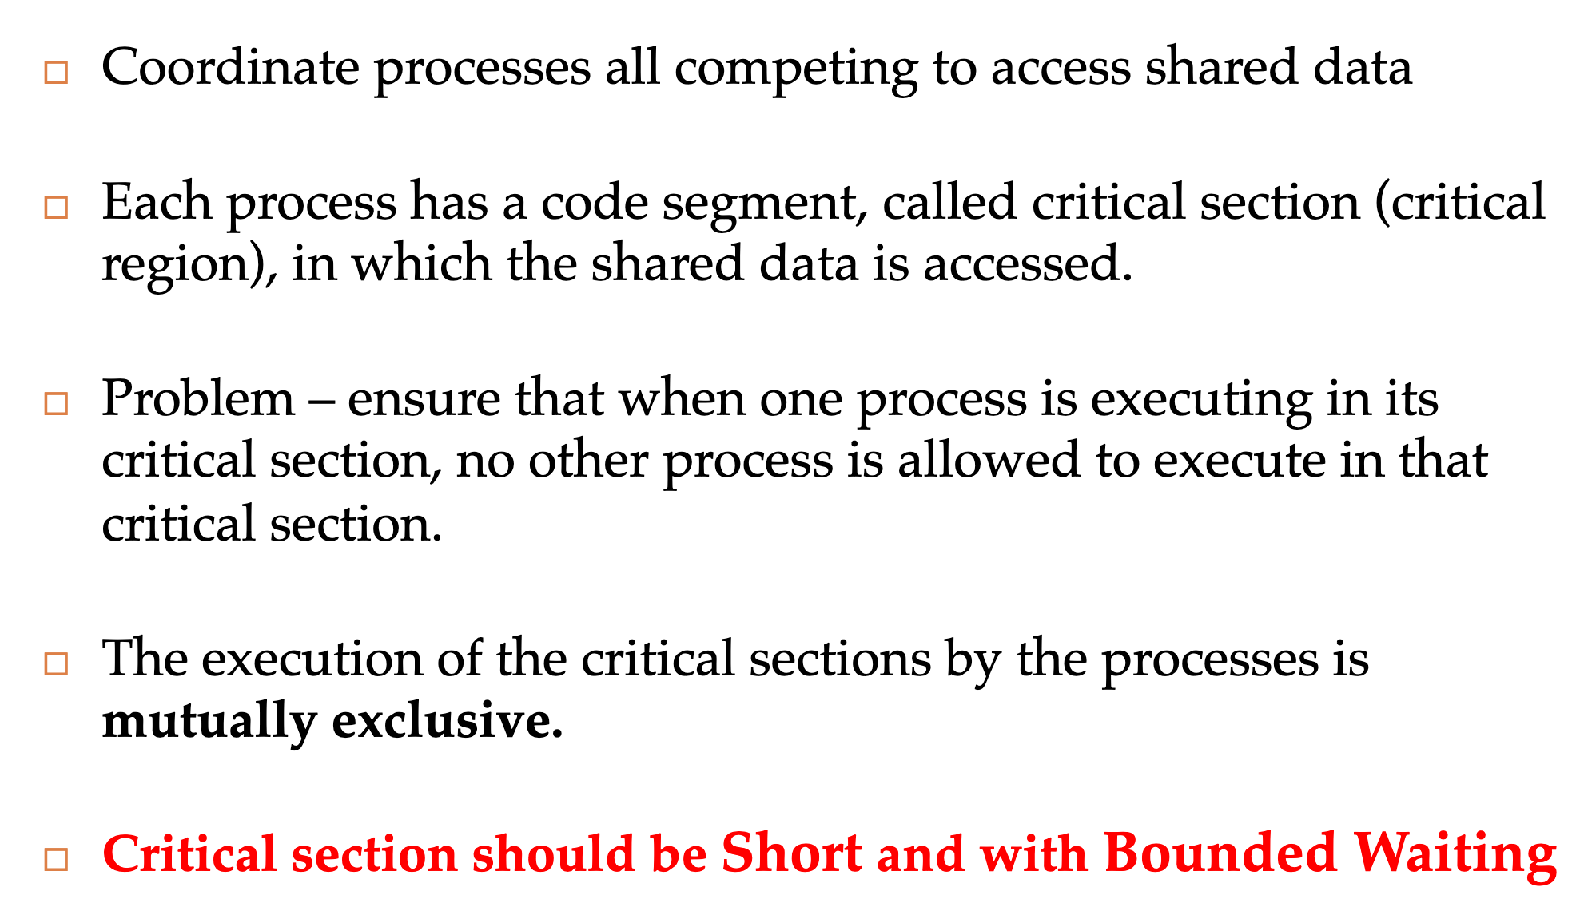
JVM execution architecture

Slide 44
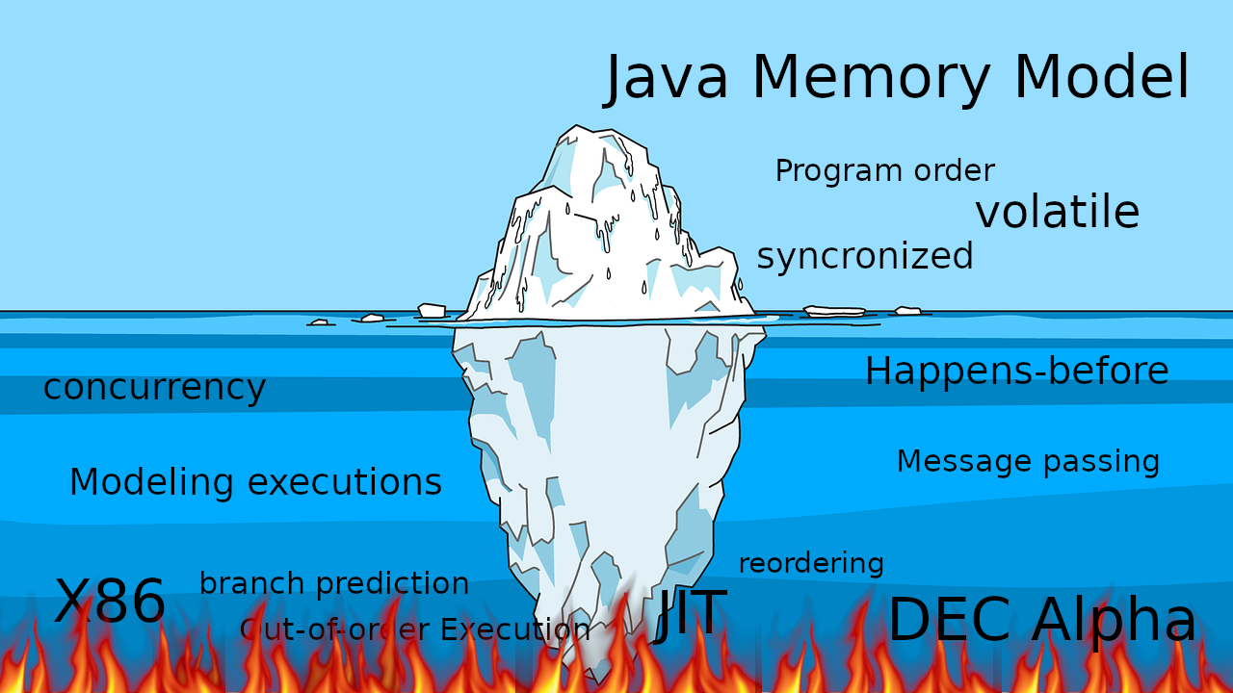
JVM execution architecture

Slide 45
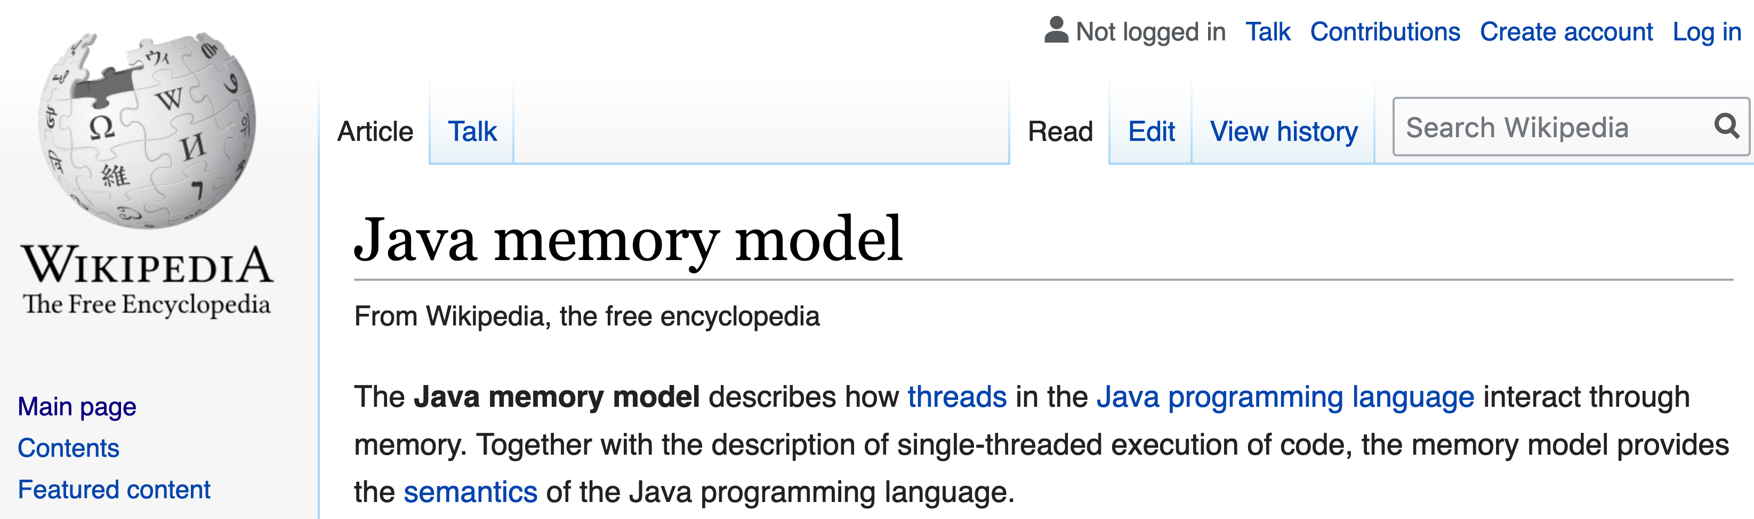
JVM execution architecture

Slide 46
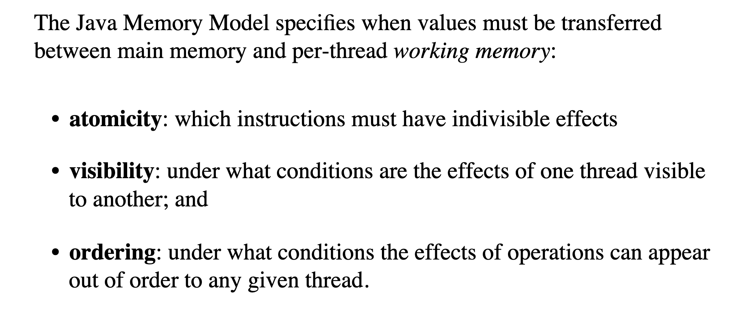
Model properties

Slide 47
CPU

Slide 48
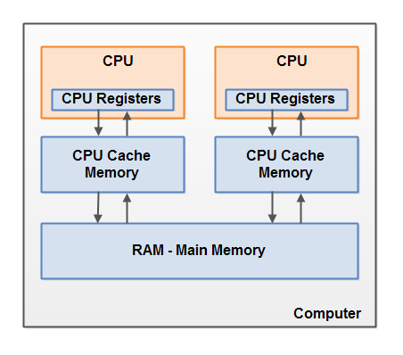
CPU

Slide 49
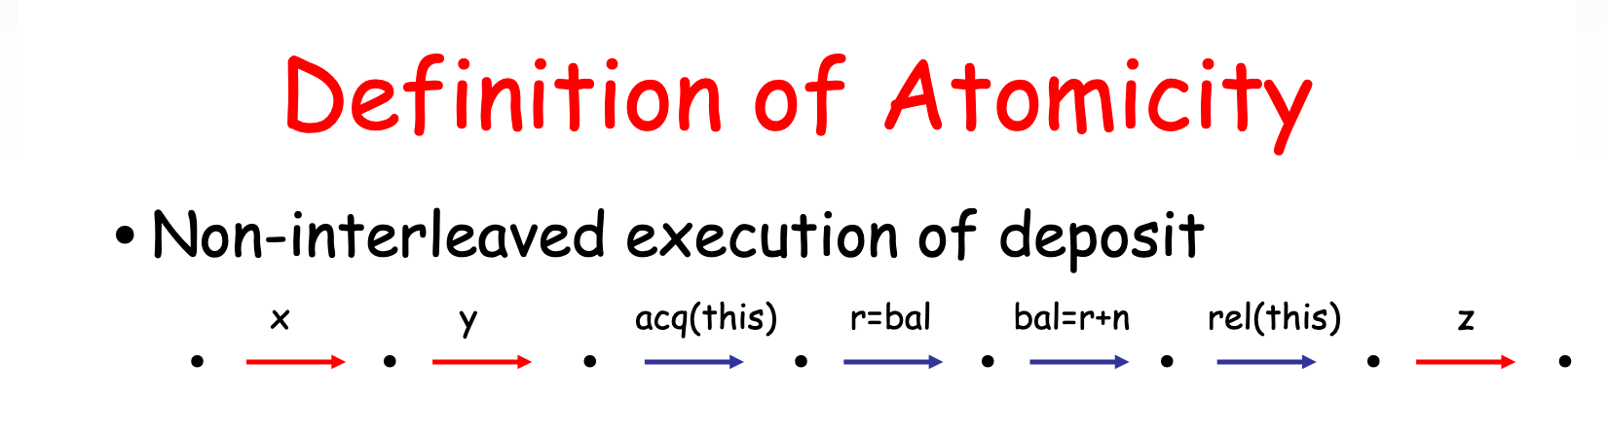
Atomicity

Slide 50
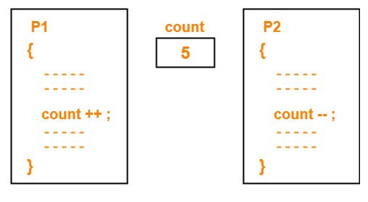
Atomicity

Slide 51
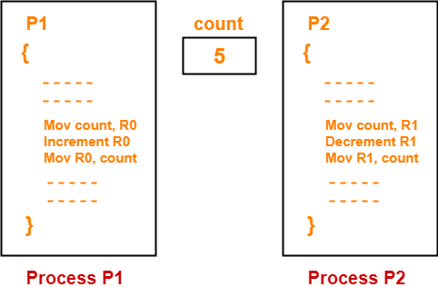
Atomicity

Slide 52
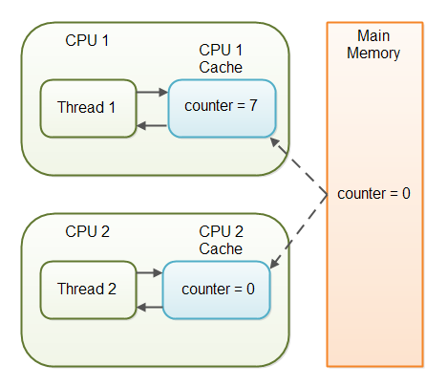
Visibility

Slide 53
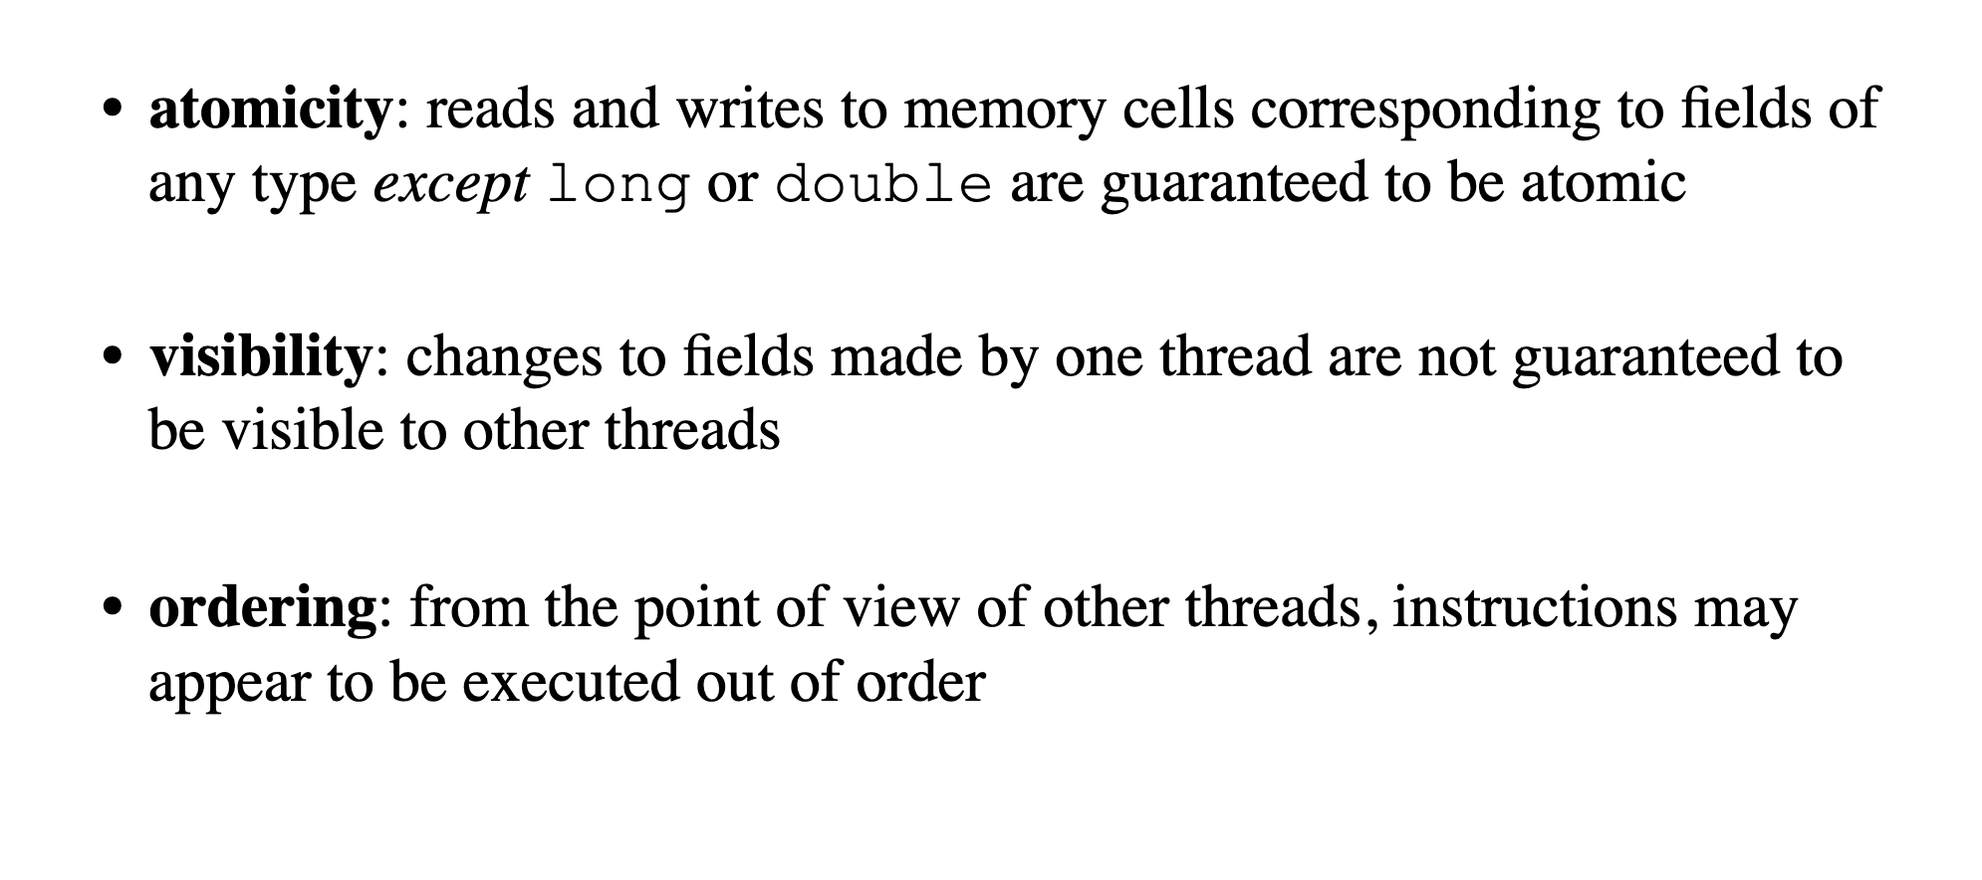
Visibility

Slide 54
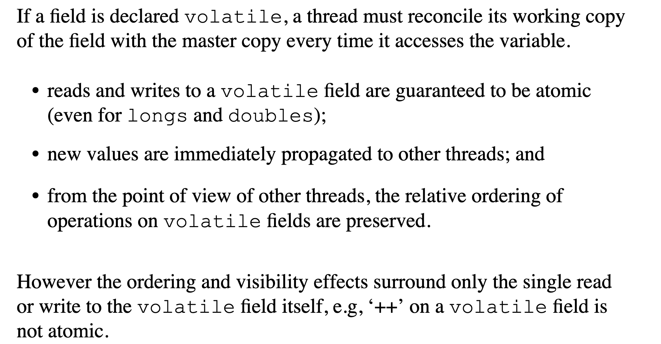
Visibility

Slide 55
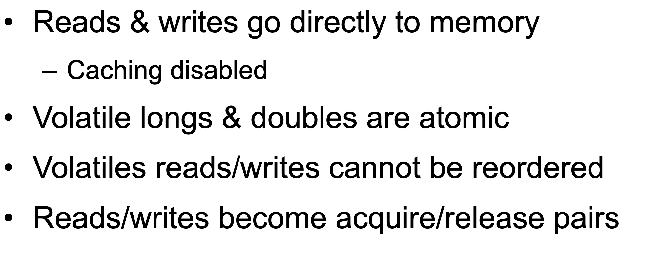
Visibility

Slide 56
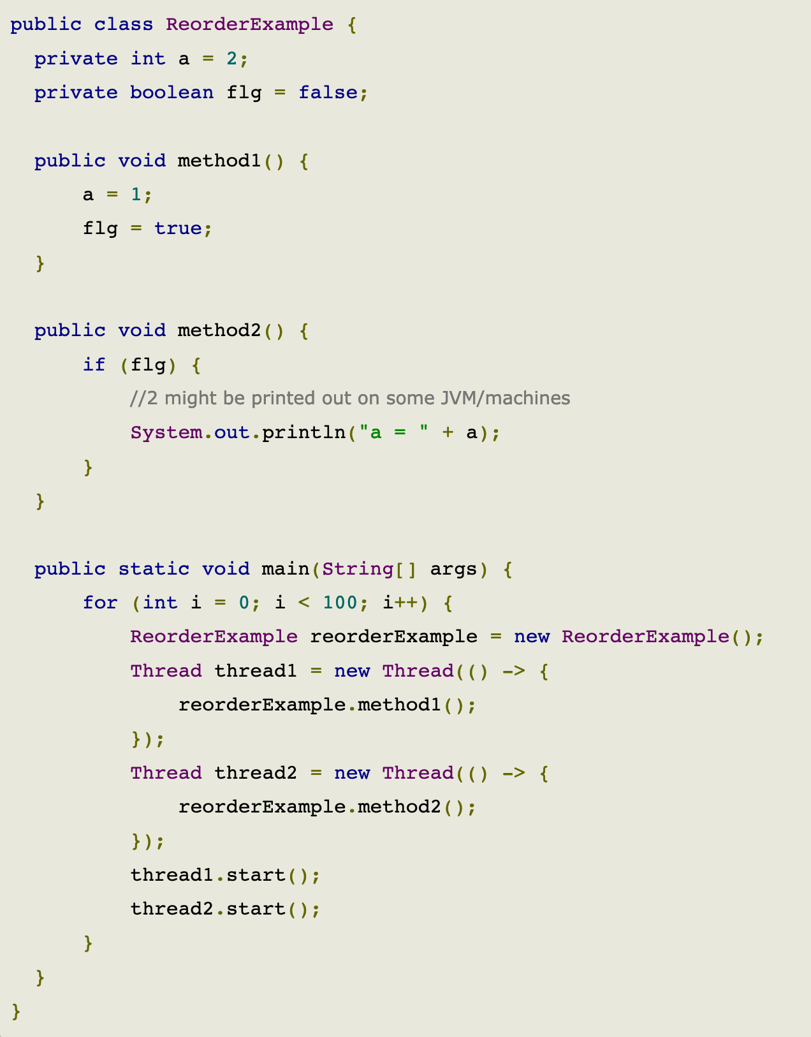
Visibility

Slide 57

Visibility

Slide 58
Visibility
Happens-before relationship is a guarantee that action performed by one thread is visible to another action in different thread.
Transitivity: If A happens-before B, and B happens-before C, then A happens-before C.

Slide 59

Visibility
Single thread rule: Each action in a single thread happens-before every action in that thread that comes later in the program order.

Slide 60

Visibility
Monitor lock rule: An unlock on a monitor lock (exiting synchronized method/block) happens-before every subsequent acquiring on the same monitor lock.

Slide 61

Visibility
Volatile variable rule: A write to a volatile field happens-before every subsequent read of that same field. Writes and reads of volatile fields have similar memory consistency effects as entering and exiting monitors (synchronized block around reads and writes), but without actually aquiring monitors/locks.

Slide 62

Visibility
Thread start rule: A call to Thread.start() on a thread happens-before every action in the started thread. Say thread A spawns a new thread B by calling threadA.start(). All actions performed in thread B's run method will see thread A's calling threadA.start() method and before that (only in thread A) happened before them.

Slide 63

Visibility
Thread join rule: All actions in a thread happen-before any other thread successfully returns from a join on that thread. Say thread A spawns a new thread B by calling threadA.start() then calls threadA.join(). Thread A will wait at join() call until thread B's run method finishes. After join method returns, all subsequent actions in thread A will see all actions performed in thread B's run method happened before them.

Slide 64
Example 5

Slide 65
How processors work?

Slide 66
Concurrent computing is a form of computing in which several computations are executed during overlapping time periods—concurrently—instead of sequentially (one completing before the next starts)
Definition

Slide 67

Sequential vs concurrent

Slide 68
Performance

Slide 69

Amdahl's law

Slide 70

Resource utilization

Slide 71

Resource utilization

Slide 72


Resource utilization

Slide 73

Latency

Slide 74

Modern way

Slide 75






Concurrent Dijkstra algorithm

Slide 76
Multi thread migration

Slide 77
Single thread migration
7h21 min 1.7 r/s

Slide 78
Multi thread migration

Slide 79
Multi thread migration
7h21 min 1.7 r/s
28 min 23 r/s

Slide 80

The show begins

Slide 81

#1 Difficult to debug

Slide 82

#2 Race condition

Slide 83

#3 Dead locks

Slide 84
Concurrency mad stuff
“But I don’t want to go among mad people," Alice remarked. - "Oh, you can’t help that," said the Cat: "we’re all mad here. I’m mad. You’re mad." - "How do you know I’m mad?" said Alice. - "You must be," said the Cat, "or you wouldn’t have come here.”
Alice's Adventures in
Wonderland by Lewis Carroll

Slide 85


Dev practices
On Java 8 by Bruce Eckel

Slide 86


Dev practices
On Java 8 by Bruce Eckel

Slide 87

#4 Non deterministic behavior

Slide 88

#4 Non deterministic behavior

Slide 89

#4 Non deterministic behavior

Slide 90

#4 Non deterministic behavior

Slide 91
Are you still here?
Twas brillig, and the slithy toves Did gyre and gimble in the wabe: All mimsy were the borogoves, And the mome raths outgrabe
Jabberwocky by Lewis Carroll

Slide 92

Let’s continue?

Slide 93

#5 Performance degradation

Slide 94

#5 Performance degradation

Slide 95

#6 OS limitation

Slide 96

Stop it? Hell no…

Slide 97

#7 Hardware unpredictable optimizations

Slide 98

Concurrency in real world
On Java 8 by Bruce Eckel

Slide 99
Conclusion
Concurrency is powerful practice, you can achieve a lot using it
Don’t use concurrency if you can avoid it
Use best practices by experts
Use frameworks with big professional community
Minimize synchronization and data sharing
Perform load and stress testing
Use as much as possible existed solutions
Don’t forget about mad world and wonders

Slide 100
Resources
Java concurrency in practice (Brian Goetz )
On Java 8 (Bruce Eckel)
The Art of Multiprocessor Programming (Maurice Herlihy , Nir Shavit )

Slide 101

THANK YOU!
artyom-karnov@yandex.ru, Saint-Petersburg, 2019

